Slide 1
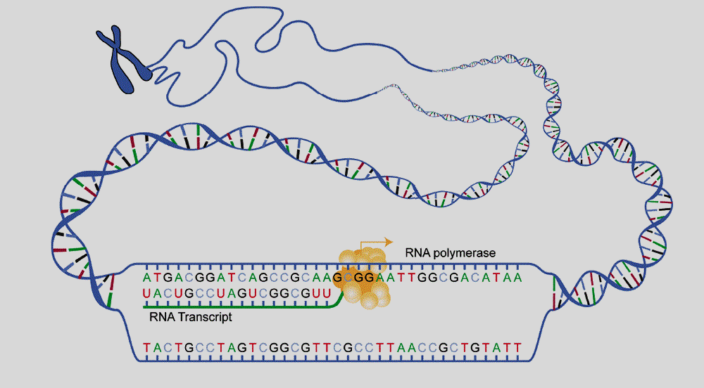
Protein Synthesis - Transcription

Slide 2
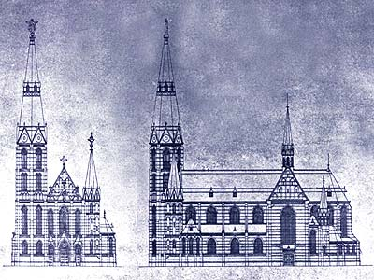
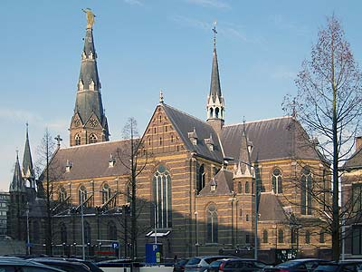
DNA codes for Proteins
Enzymes do the nitty-gritty jobs of every living cell.
The importance of DNA is that it contains the information that is used to make all of the proteins on which life depends.
DNA is the blueprint
Proteins are the product

Slide 3
But how do we get from DNA to proteins? (2:53)

Slide 4
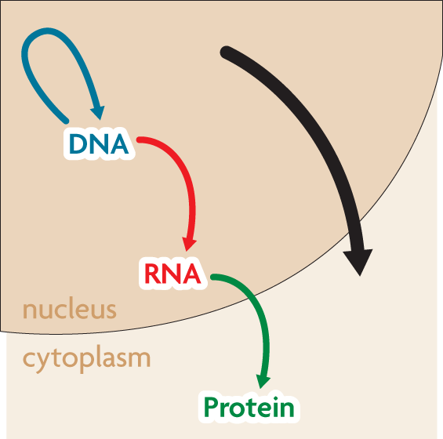
The Central Dogma
The central dogma states that information flows in one direction from DNA to RNA to proteins.

Slide 5
Transcription
Converting a gene from the DNA blueprint into a complimentary single-stranded RNA sequence

Slide 6
The central dogma includes three processes:
Replication
Transcription
Translation
replication
transcription
RNA is a link between DNA and proteins.
translation

Slide 7
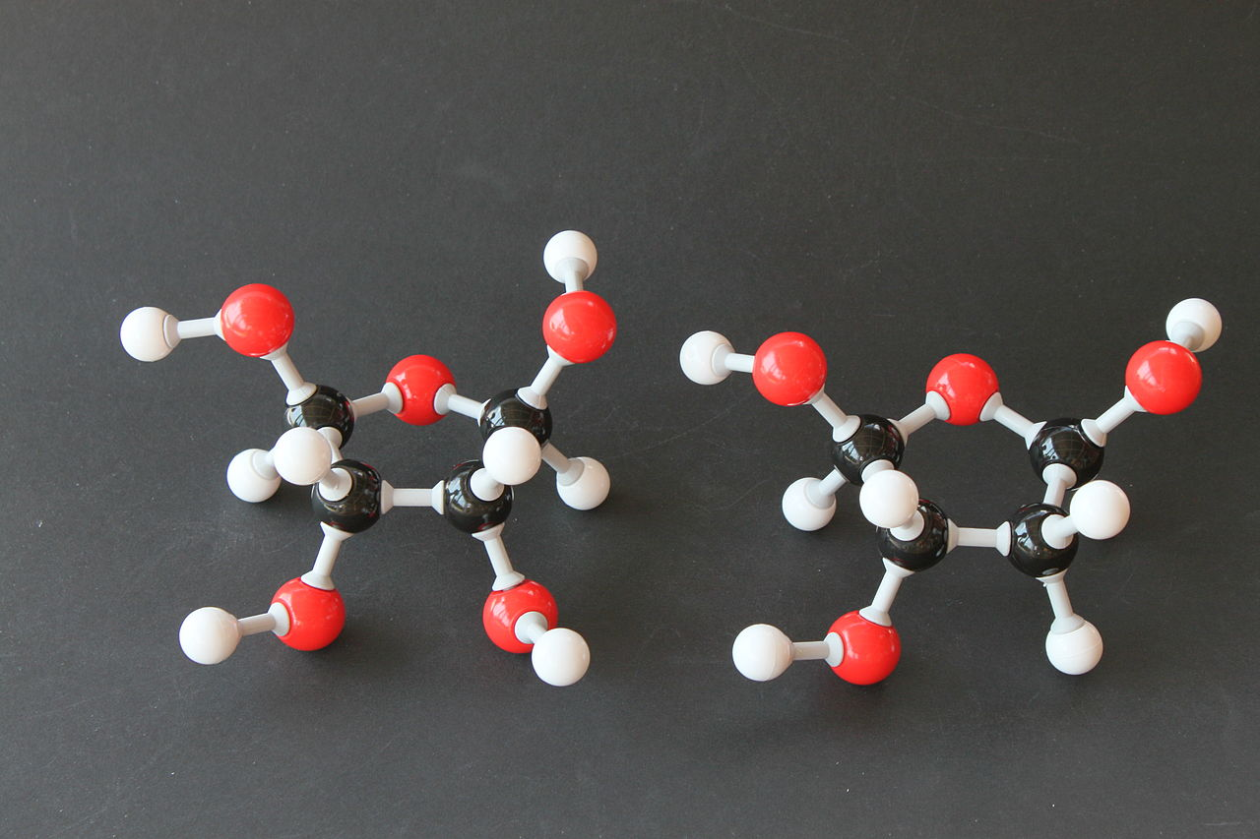
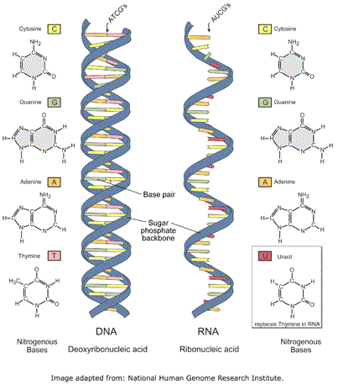
RNA is very similar to DNA
However, it differs in 3 major ways:
RNA has a ribose sugar.
RNA has uracil instead of thymine.
RNA is a single-stranded structure.

Slide 8
RNA may fold and take many shapes (0:30)

Slide 9
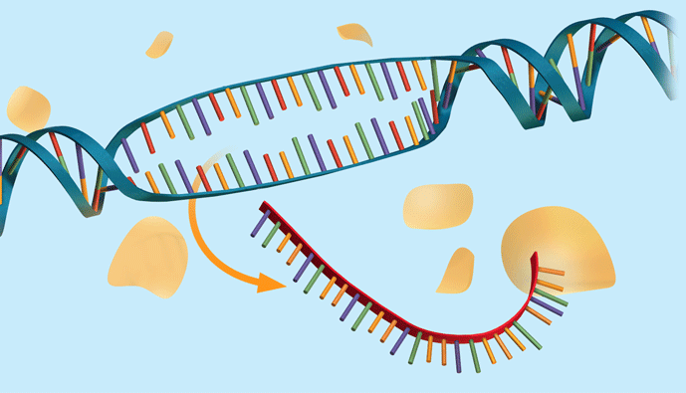
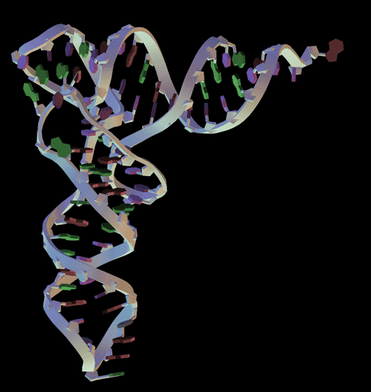
Protein Synthesis uses 3 types of RNA
Three forms of RNA involved in protein synthesis
1. mRNA (messenger): copies instructions from DNA and carries these to the ribosome.
2. tRNA (transfer): carries amino acids from the cytoplasm to the ribosome.
3. rRNA (ribosomal): composes parts of the ribosome, which is the site of protein synthesis

Slide 10
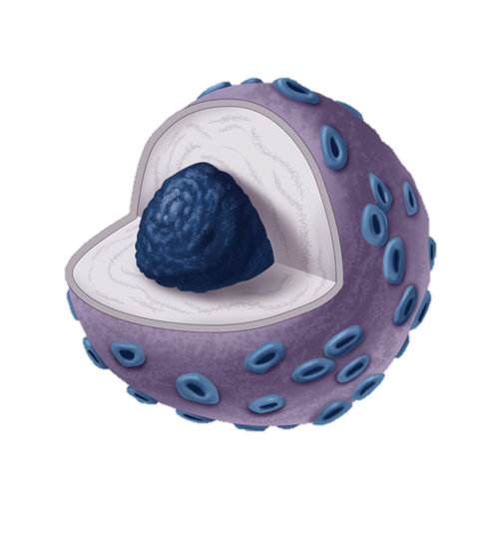
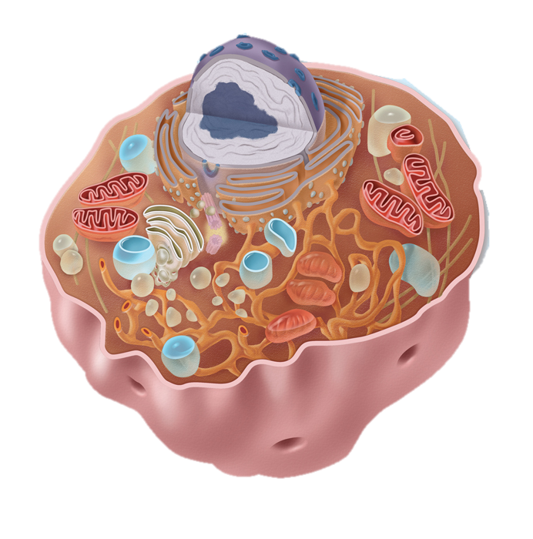
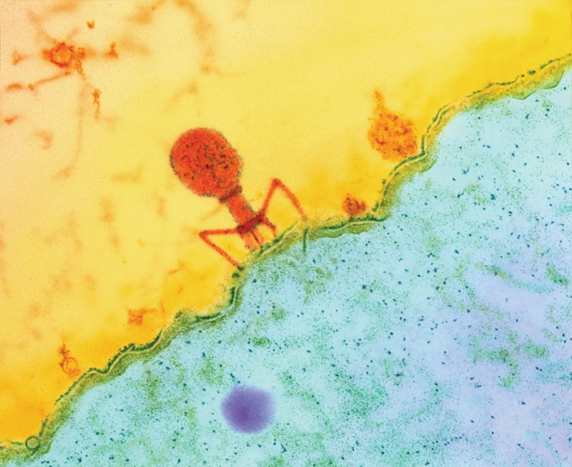
Transcription Occurs in the Nucleus
Transcription copies DNA to make a complimentary strand of RNA
This takes place inside the nucleus
What advantage(s) might this create?
DNA is more protected from splicing and mutagens. Also, it is better regulated

Slide 11
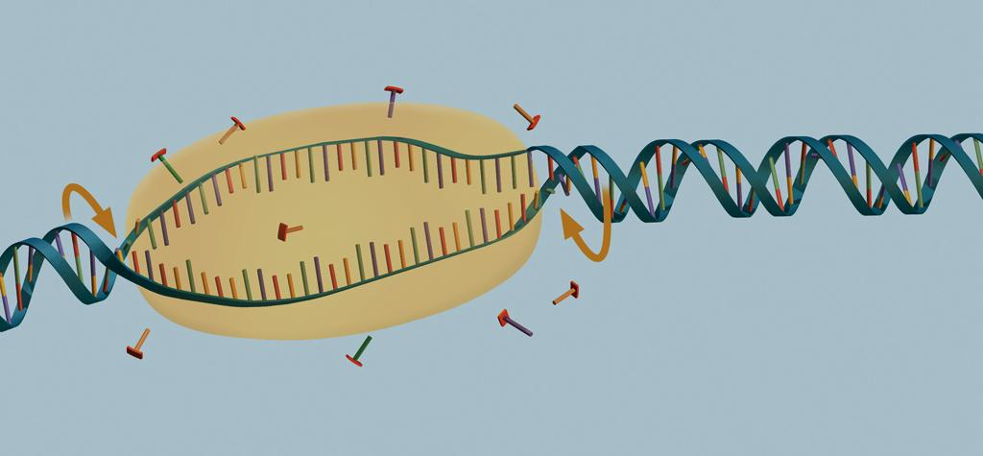
How Transcription Occurs
1. RNA polymerase untwists and unzips a section of the DNA (usually a single gene).
transcription complex
start site
nucleotides

Slide 12
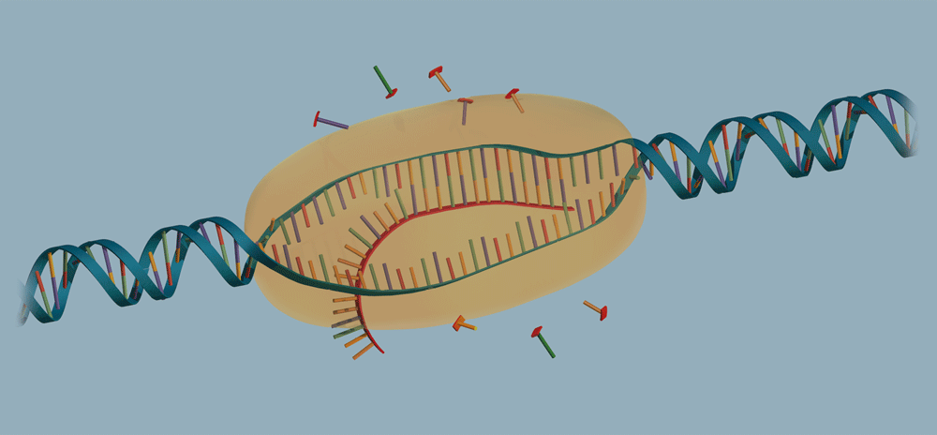
2. RNA polymerase pairs free RNA nucleotides to the exposed bases of one of the DNA strands following base pair rules, except Uracil replaces thymine
3. The DNA helix winds again as the gene is transcribed.
DNA
RNA polymerase moves along the DNA

Slide 13
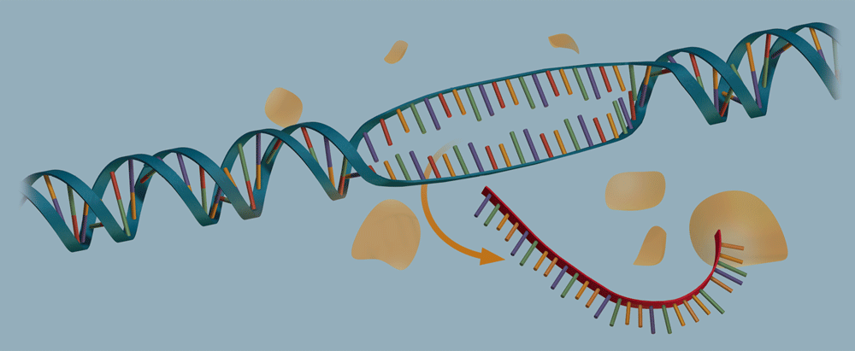
4. The RNA strand detaches from the DNA once the gene is transcribed.
5. The mRNA strand, with instructions for building a protein, leaves the nucleus and enters the cytoplasm
RNA

Slide 14
TRANSCRIPTION EXAMPLE
Transcribe the following DNA Sequence into mRNA
Template DNA:
TAC CGG ATG CTA GGA TCA
AUG GCC UAC GAU CCU AGU
Notes:
14

Slide 15
How is DNA replication similar to transcription? How are the two processes different?

Slide 16
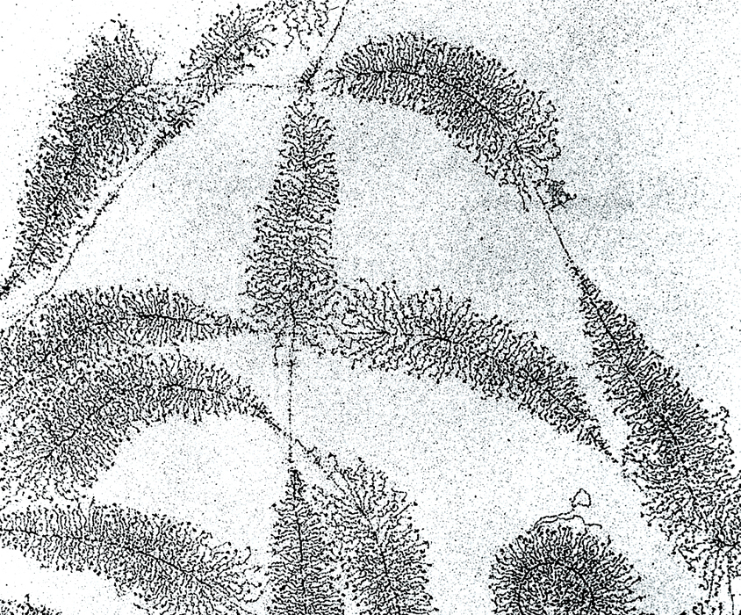
The transcription process is similar to replication
Transcription and replication both involve complex enzymes and complementary base pairing
The two processes have different end results.
Replication copies the entire DNA; transcription copies a gene.
Replication makes one copy; transcription can make many copies.
Which direction is transcription occurring?
one
gene
growing RNA strands
DNA

Slide 17
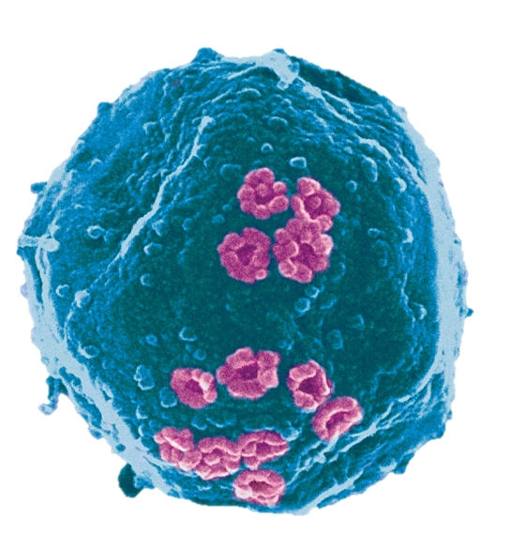
Result of Transcription
Completed mRNA template leaves the nucleus
What do you notice about this molecule?? (compared to DNA)

