Slide 1
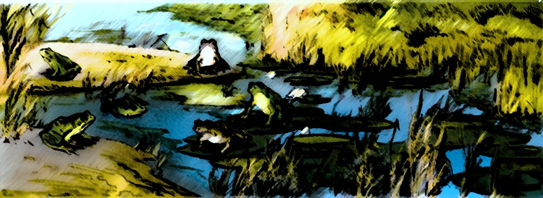
Mutations

Slide 2
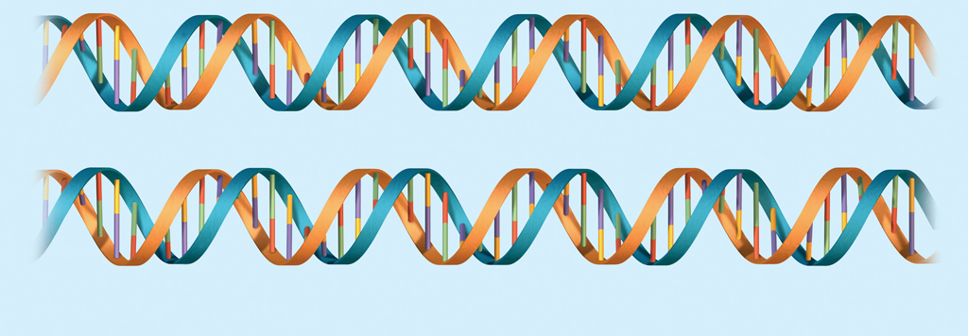
Mutations
A Mutation is a change in an organism’s DNA
It can occur naturally whenever a base is incorrectly copied, especially during DNA Replication.
It can also occur as a result of DNA damage from environmental causes.

Slide 3
Sources of Mutations
Induced mutations happen at a much higher frequency than naturally occurring ones
Chemical
Physical
Biological
Spontaneous
Radiation: UV, X-ray
Asbestos
Nicotine, alkaloids, amines
Viral Infections
Rare, naturally occurring
Normal free radicals used in digestion

Slide 4
The Genetic Code and its Translation
Regardless of the organism, codons code for the same amino acid

Slide 5
Point Mutations
Many types of mutations can occur
Point mutations substitute one nucleotide for another, resulting in a new codon
Point Mutations
Silent
Missense
Nonsense

Slide 6
Silent Mutations
The result is either the same amino acid as before or
An amino acid that does not affect the shape of the protein and therefore does not affect its functioning.
We are generally unaware of these “quiet mutations”
UCG
Point Mutation
Changes G►A
Serine
UCA
Serine

Slide 7
Missense Mutations
The result is that one amino acid is changed
That change will affect just that area of the protein and will likely affect functioning of the protein
It makes sense, but not the right sense
UCG
Point Mutation
Changes U►A
Threonine
ACG
Serine

Slide 8
For Example: Sickle Cell Anemia
A single nucleotide change causes a missense point mutation that results in abnormally folding proteins and deformed red blood cells.

Slide 9
Nonsense Mutations
Nonsense mutations generate a STOP codon
This causes coding to terminate early and only a fragment will be translated; it is not complete
After one of these, the protein is non-functioning
UCG
Point Mutation
Changes C►A
STOP CODON
UAG
Serine
What if a missense mutation caused a stop codon to be removed?

Slide 10
There are other more complex mutations that can occur
Frameshift Mutations
Gene Translocations
An insertion or deletion of a nucleotide alters the way every codon is read in the sequence
Sections of non-homologous chromosomes can be rearranged

Slide 11
DNA is Under Constant Attack (1:06)

Slide 12
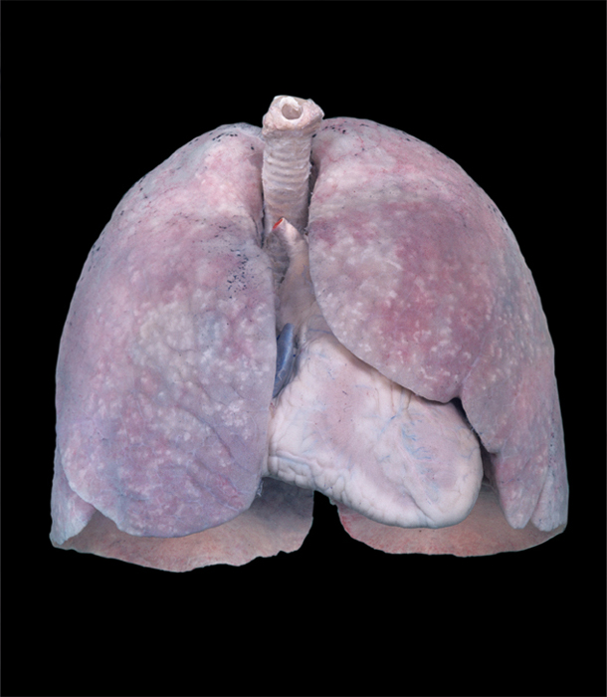
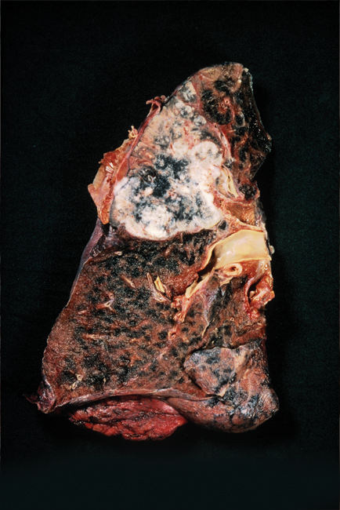
Cancer
All cancers are due to accumulated mutations, including affecting genes that control cell division
Some people have a genetic predisposition for a certain type of cancer
Photographs of lobes of health and cancerous lung tissue

Slide 13
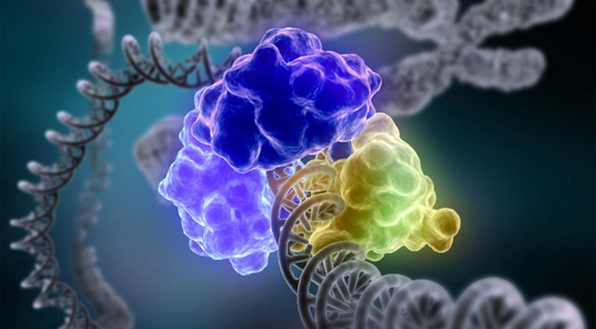
Correcting Mutations
Just so you know…
There are a number of different enzyme systems that proofread and repair DNA
It is estimated that only 1 is every 100,000 mutations go uncorrected

Slide 14
What do you think…?
How would it be different if a mutation occurred in a somatic cell compared to a gamete?

Slide 15
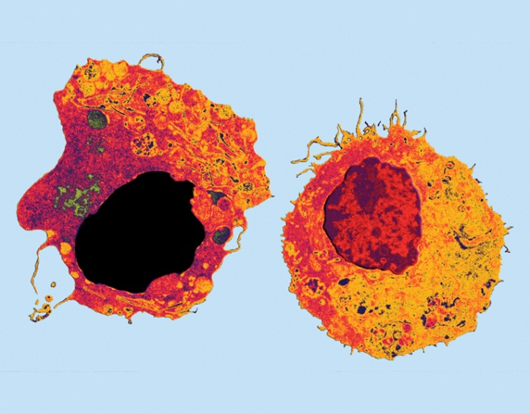
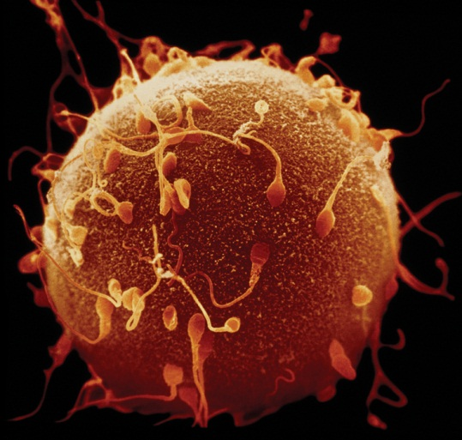
The Heredity of Mutations
Body Cell Mutations
If the mutation occurs in somatic cells, it will be restricted to the tissues of a single organism, not passing it to the next generation
Sex Cell Mutations
If the mutation occur in the reproductive cells, they may be transmitted by gametes to the next generation

Slide 16
Mutations may or may not affect Phenotype
Some mutations affect phenotype
Some mutations do not affect phenotype
A mutation…
may cause a premature stop codon
may change protein shape or the active site
may change gene regulation
in sex cells can be harmful or beneficial to offspring
A mutation…
may be silent
may occur in a noncoding region.
may not affect protein folding or the active site
in body cells do not affect offspring

