Slide 1
Biodiversity of World Biomes

Slide 2
The Biosphere
In 2011 (updated from 2002), about 8.7 million species had been discovered and identified by biologists.
The sum of Earth’s ecosystems, the Biosphere encompasses all parts of the planet inhabited by living things.

Slide 3
Terrestrial Biomes
The term biome refers to a major type of terrestrial ecosystem that typifies a broad geographical region. It is a major regional community of organisms.
Characterized by the climate conditions and plant communities that thrive there.
Weather is a daily description whereas climate is a long term description of a region
Eg. Temperate vs. tropical

Slide 4
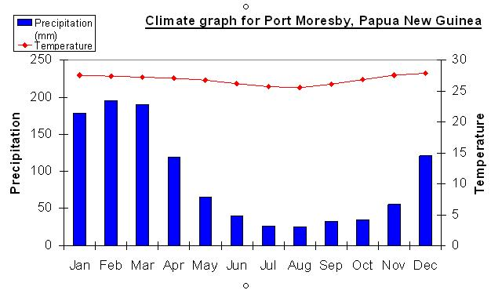
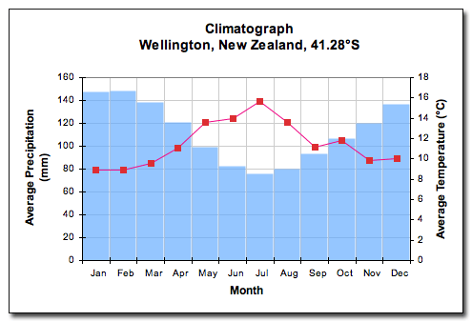
Climate Graphs
Average monthly precipitation and temperature describe climate.
Temperate vs. tropical climate graphs.

Slide 5
6 Major Terrestrial Biomes:
taiga (coniferous, needle leaf or boreal forests)
grassland
tropical rain forest
tundra (arctic and alpine)
temperate forest (deciduous and coniferous)
desert

Slide 6
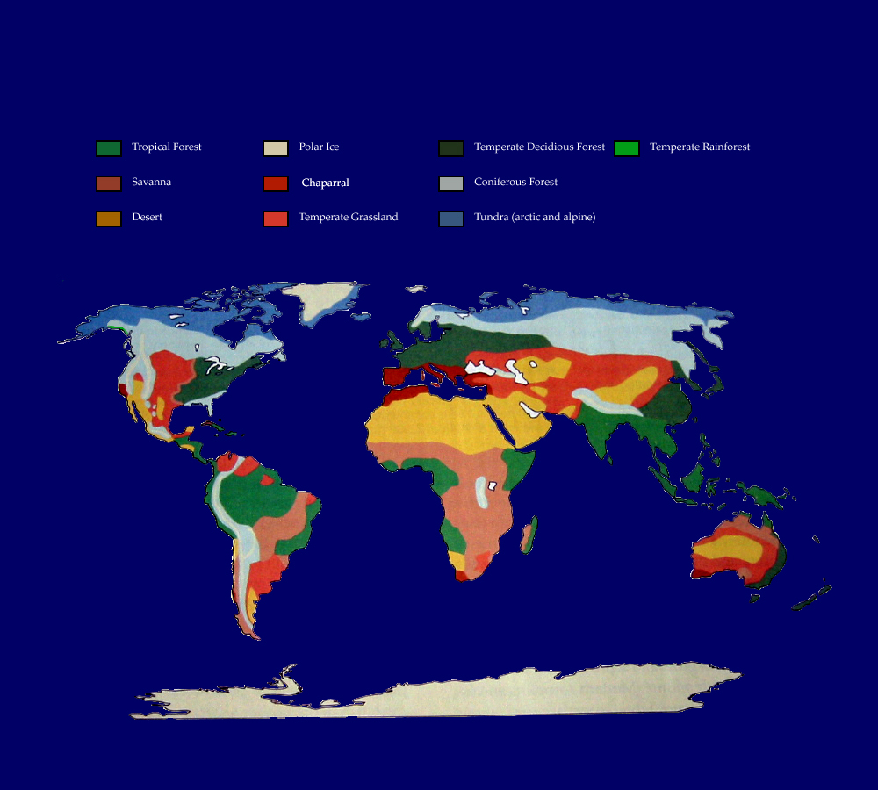
Terrestrial Biomes
The following 6 slides will show pictures of the 6 terrestrial biomes.
As we discuss each biome, please fill out both the climate and plant communities in the appropriate location on your notes.
Distribution of World Biomes

Slide 7
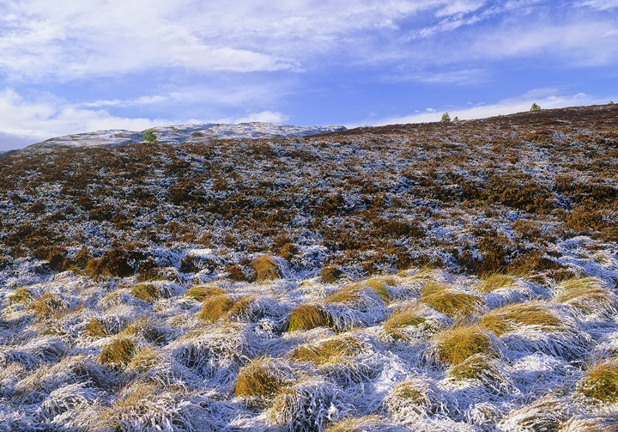
Tundra (arctic and alpine):

Slide 8
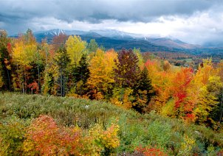
temperate forest (deciduous and coniferous)

Slide 9
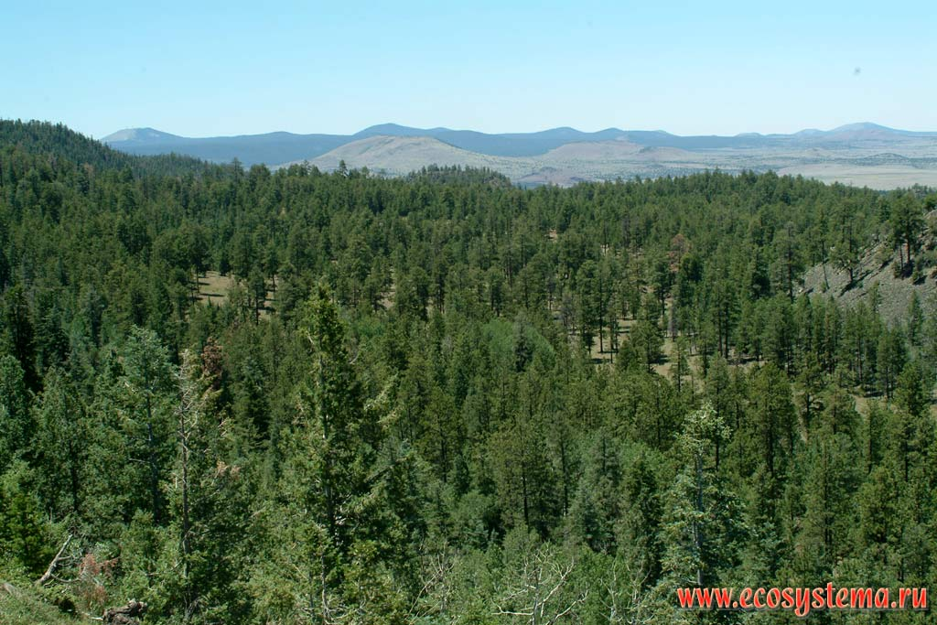
taiga (coniferous, needle leaf or boreal forests)

Slide 10
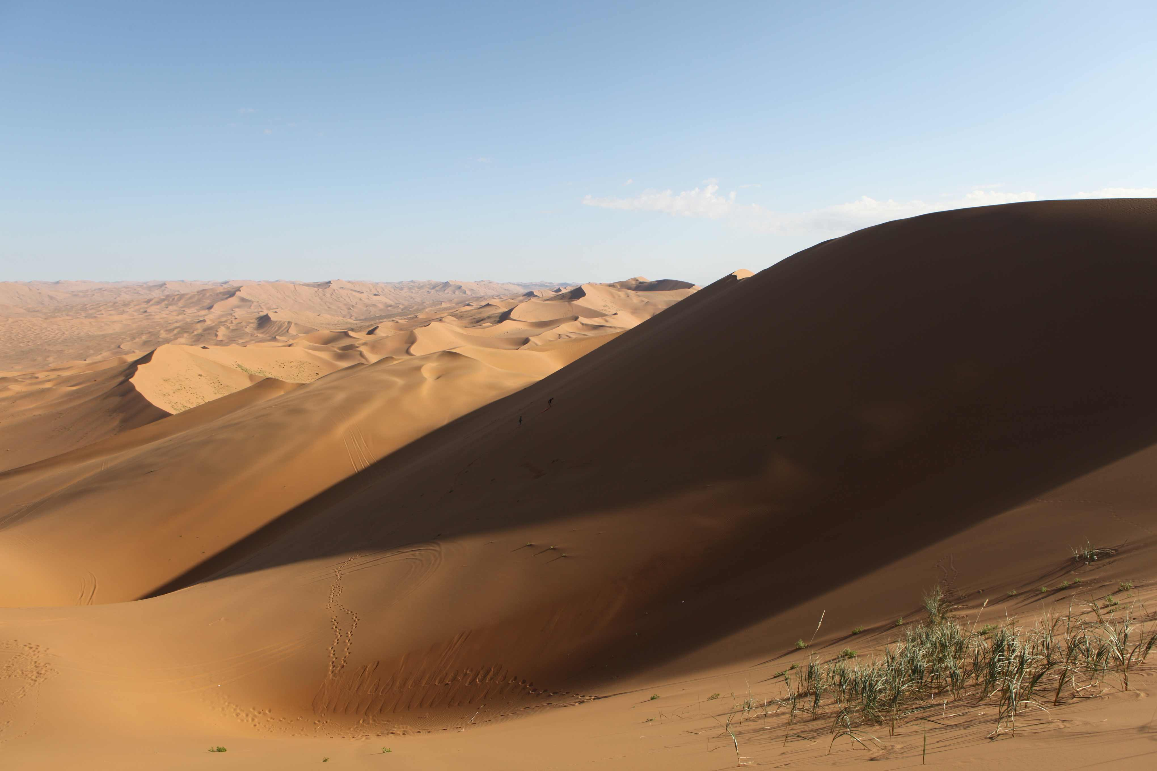
Desert

Slide 11
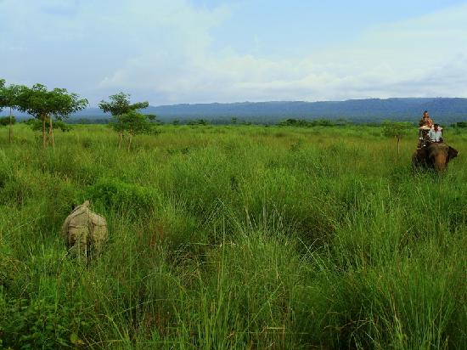
grassland

Slide 12
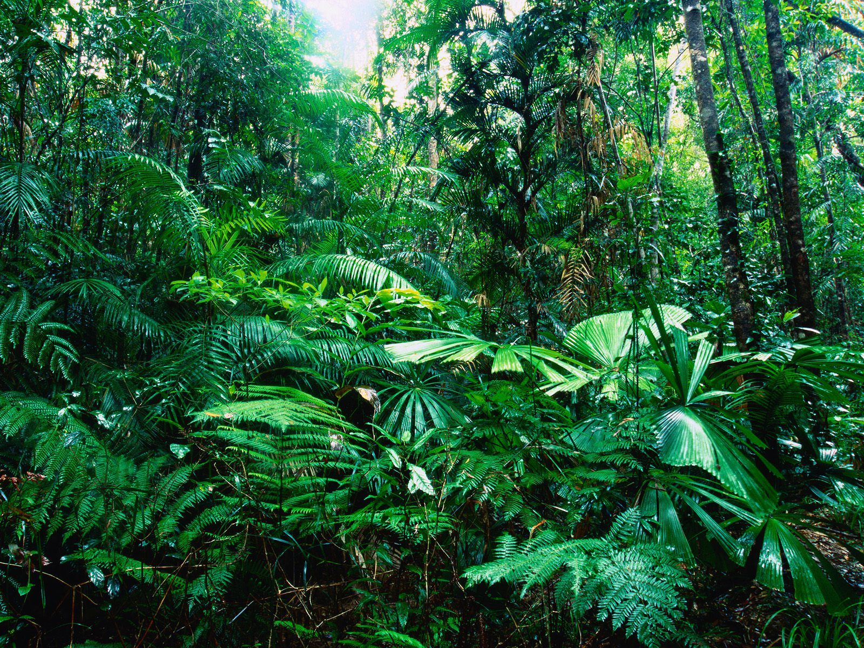
tropical rain forest

Slide 13
Marine Biomes
There are 4 marine Biomes
Ocean-Intertidal Zone
Ocean-Coral Reefs and Kelp Forests
Ocean-Bathyal Zone
Ocean-Abyssal Zone

Slide 14
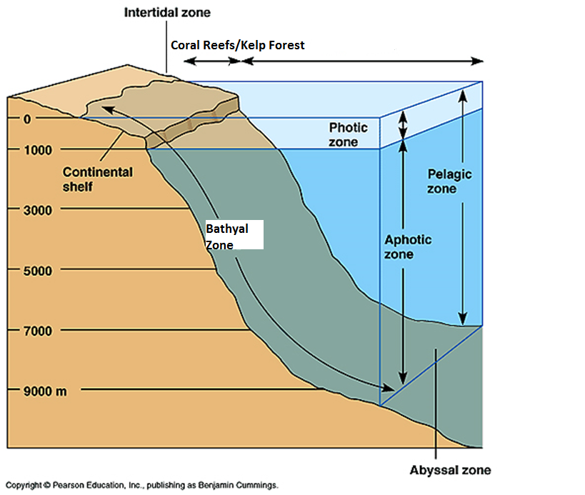
V

Slide 15
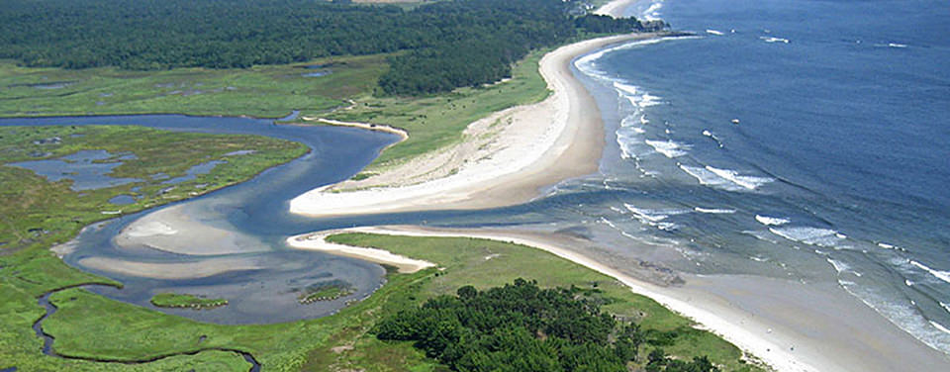
Estuaries and Freshwater Biomes
Estuaries
Freshwater (wetlands and rivers)
Ponds and Lakes

Slide 16
Estuaries and Freshwater Biomes
Please put a check next to the appropriate box in the table.
Biome | Mix of Salt and Fresh Water | Fresh Water | Moving | Standing
Estuaries | X |  | X
Rivers and Streams
Ponds and Lakes and Wetlands

Slide 17
Estuaries and Freshwater Biomes
Please put a check next to the appropriate box in the table.
Biome | Mix of Salt and Fresh Water | Fresh Water | Moving | Standing
Estuaries | X |  | X
Rivers and Streams |  | X | X
Ponds and Lakes and Wetlands

Slide 18
Estuaries and Freshwater Biomes
Please put a check next to the appropriate box in the table.
Biome | Mix of Salt and Fresh Water | Fresh Water | Moving | Standing
Estuaries | X |  | X
Rivers and Streams |  | X | X
Ponds and Lakes and Wetlands |  | X |  | X

Slide 19
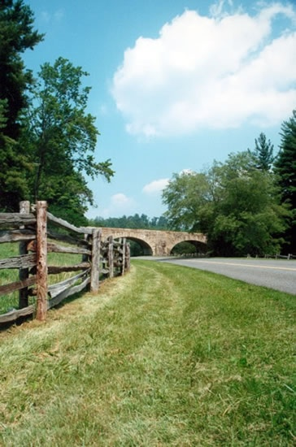
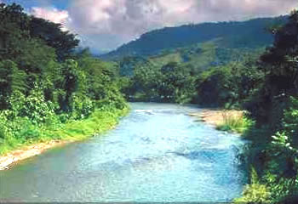
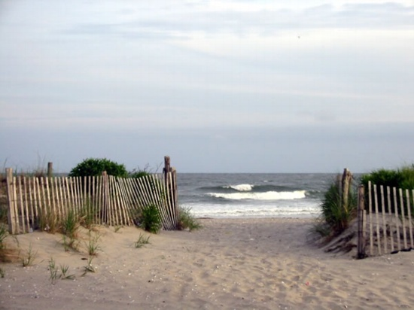
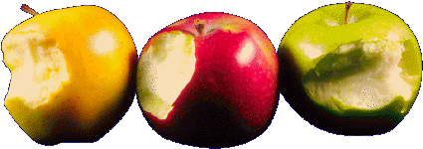
Biodiversity
For at least 3.8 billion years, a complex web of life has been evolving here on Earth.
Biodiversity ( short for biological diversity) - is the variety of all living organisms and their interactions in an ecosystem. Scientists often speak of three levels of diversity –
Genetic
Species
and ecosystem diversity.
Ecosystem
Species
Genetic

Slide 20
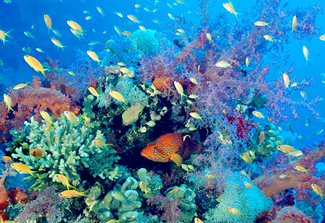
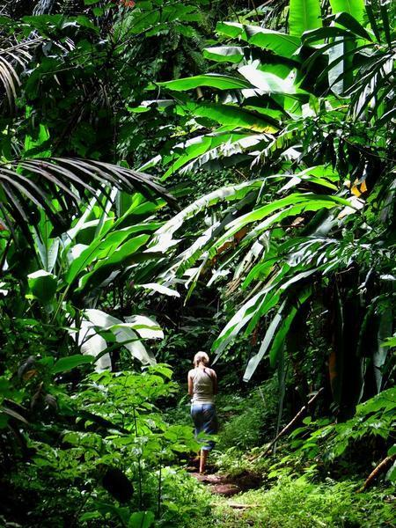
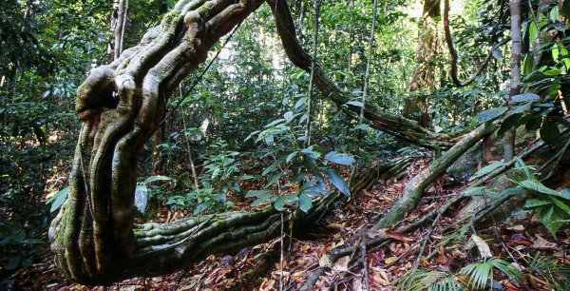
Biodiversity
An ecosystem’s health is typically measured in how much biodiversity it has.
The loss of even a single species can harm the overall stability of an ecosystem

Slide 21
What Would Happen If…
the grass population was wiped out?
the grass population recovered, but many of the marmots died because of a disease?

Slide 22
Biodiversity Hotspots
Example: Tropical Rain Forests
Warm and moist environment
Cover less than 7% of the Earth’s ground surface
Over 50% of all the planet’s species.
Important to conserve!-Why?...
Hotspot Defined:
Areas rich in biodiversity but threatened by human activity.

Slide 23
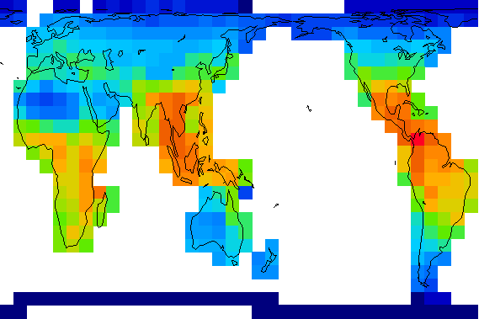
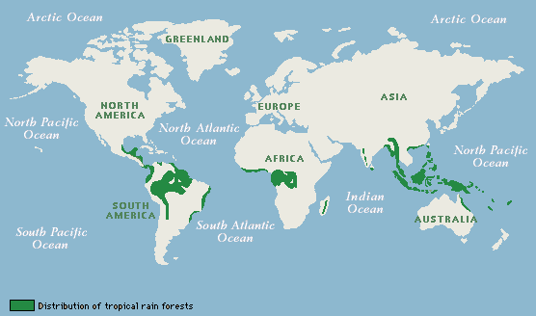
Biodiversity
The most biodiversity occurs in warm humid areas like rainforests.and coral reefs

Slide 24
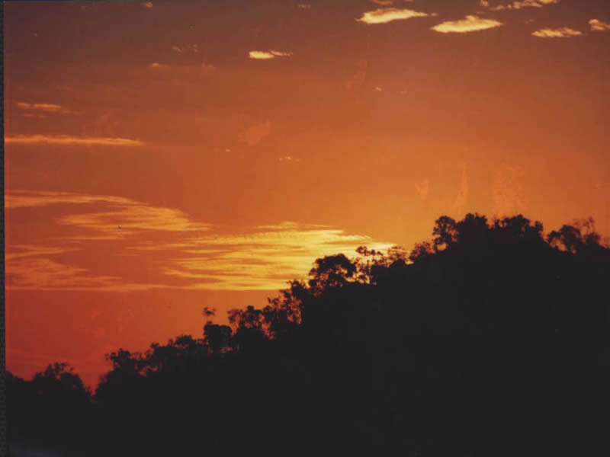
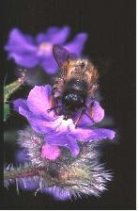
Importance of Biodiversity
Reasons human cultures value biodiversity: The rich variety of species in biological communities gives us food, wood, fibers, energy, raw materials, industrial chemicals, and medicines, all of which pour hundreds of millions of dollars into the world economy each year. People have a natural affinity for nature, a sense of “biophilia,” wherein they assign a non-utilitarian value to a tree, a forest, and wild species of all kinds
E. O. Wilson

