Slide 1
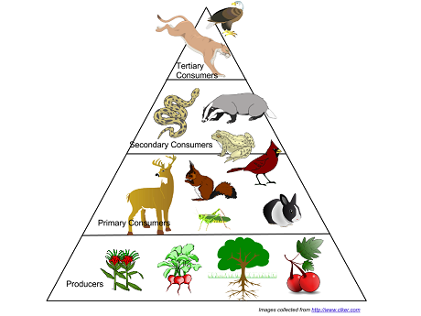
Ecological Pyramids

Slide 2
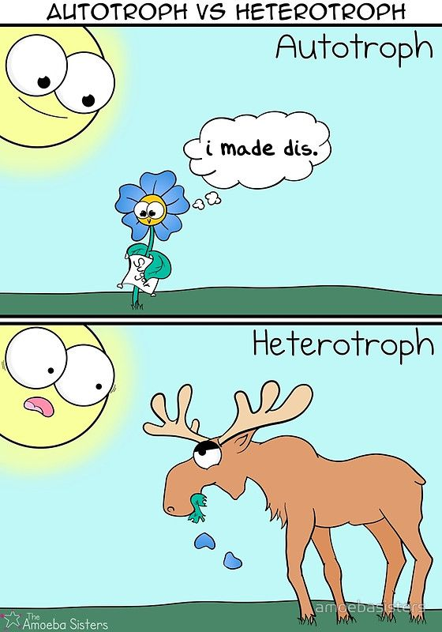
TROPHIC LEVELS
An organism’s trophic (feeding) level is determined by the organism’s source of energy.
We can classify organisms into two main types based on their trophic level.
Autotrophs
Heterotrophs

Slide 3
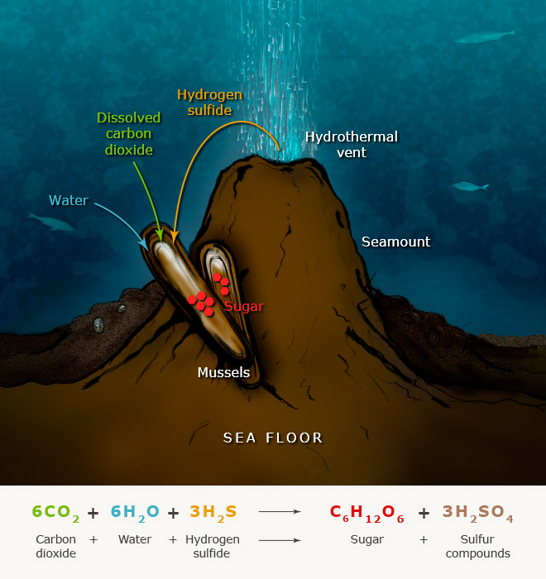
AUTOTROPHS (AKA: Producers):
Capture energy from the sun (photosynthetic) or from inorganic molecules (chemosynthetic) and converts it into usable energy (sugar).
Examples: All plants & algae and some types of bacteria.

Slide 4
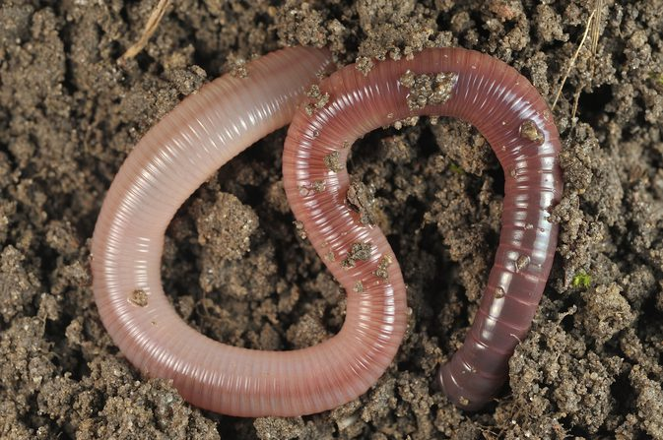
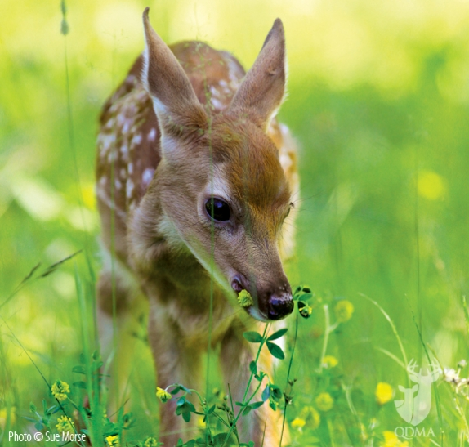
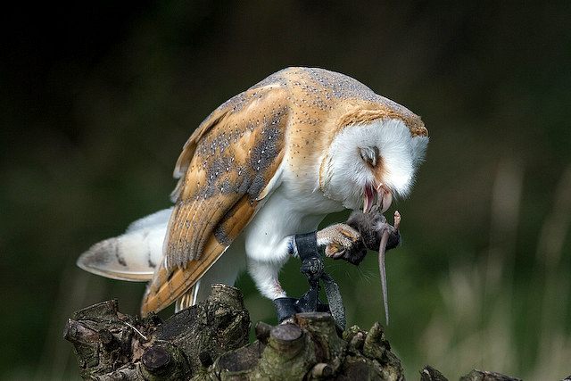
HETEROTROPHS (AKA: Consumers
Obtain energy to build their molecules by consuming plants or other organisms
Examples:
1⁰, 2⁰, etc… consumers
Scavengers
Decomposers

Slide 5
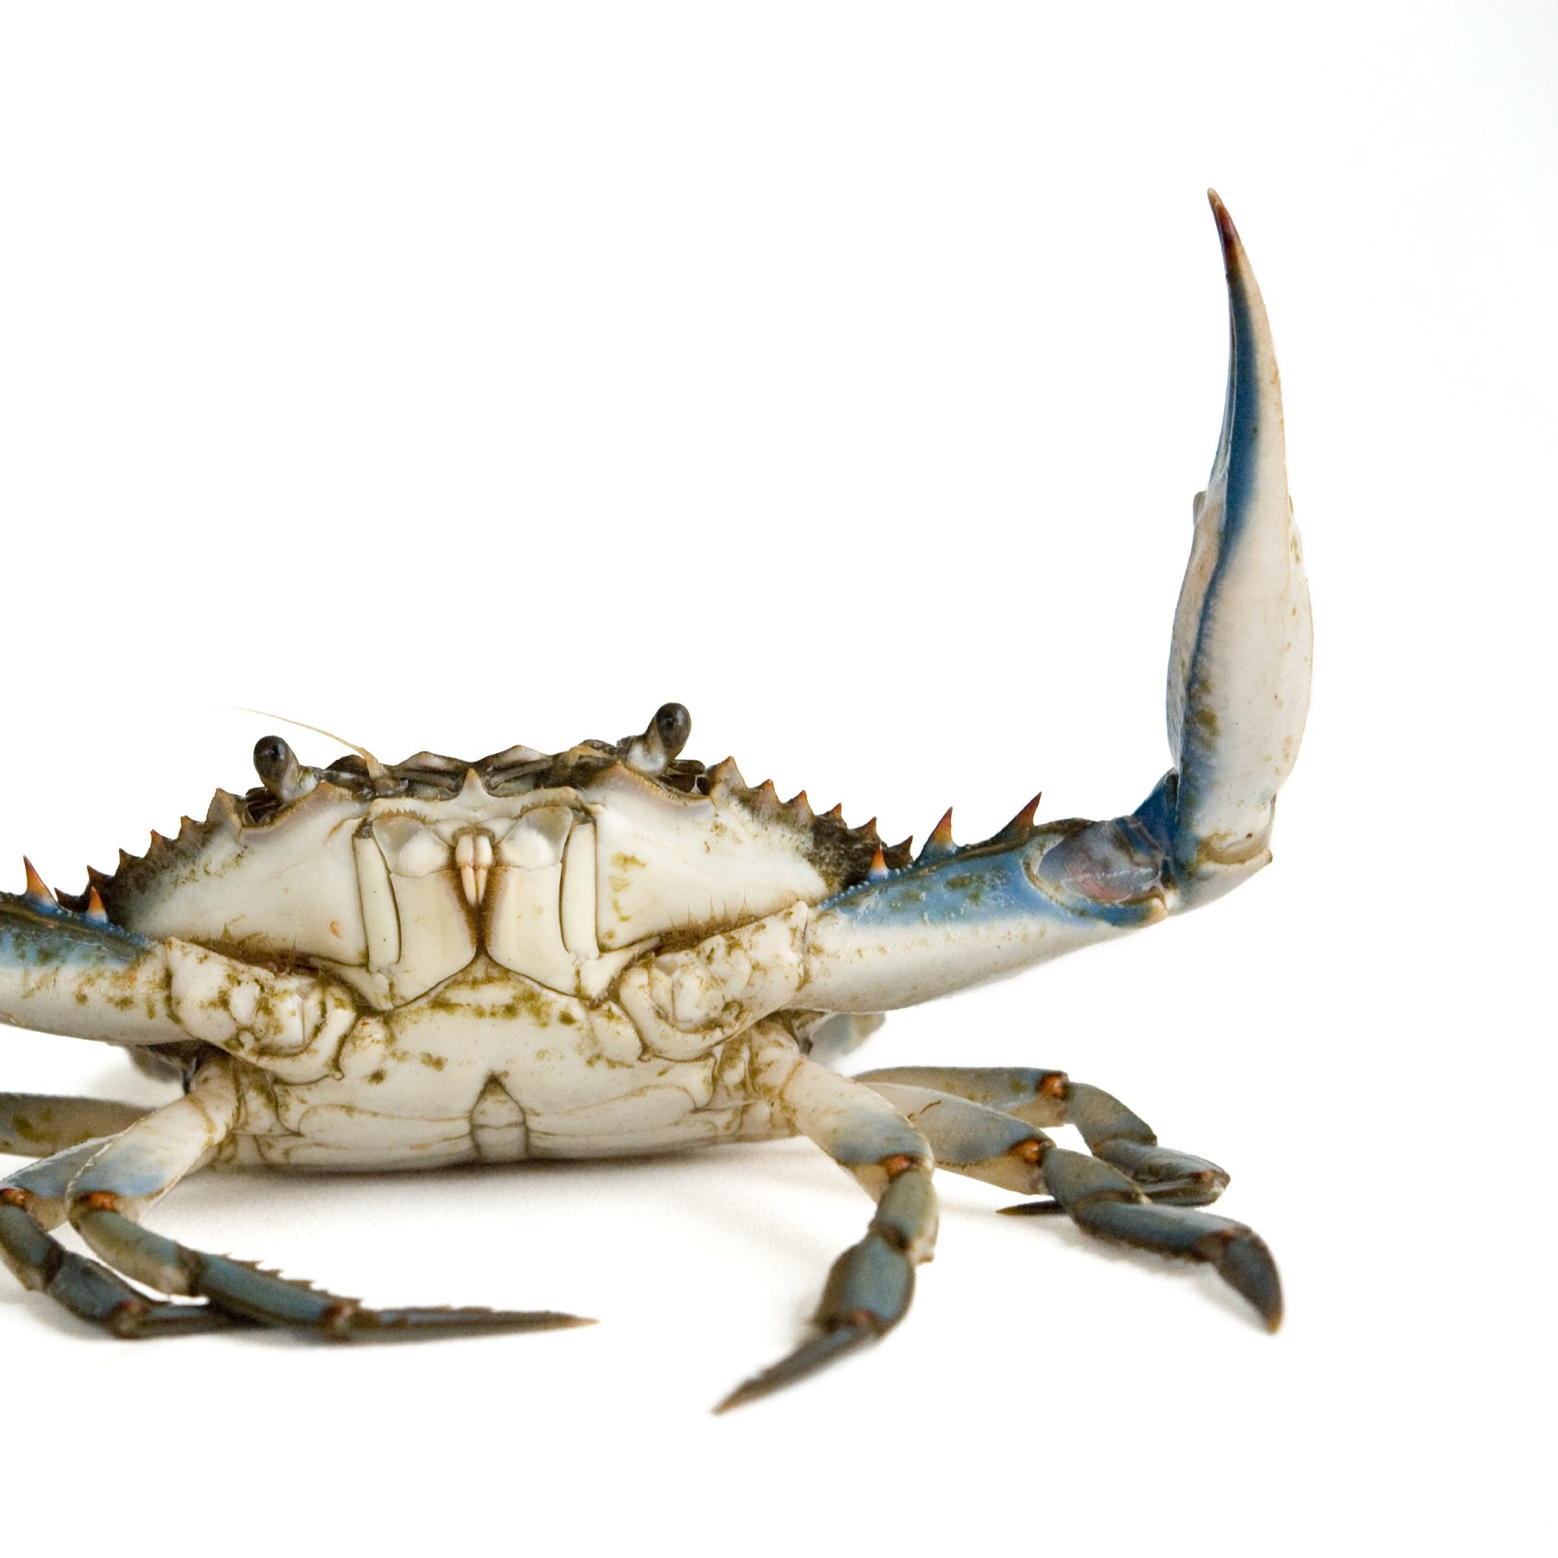
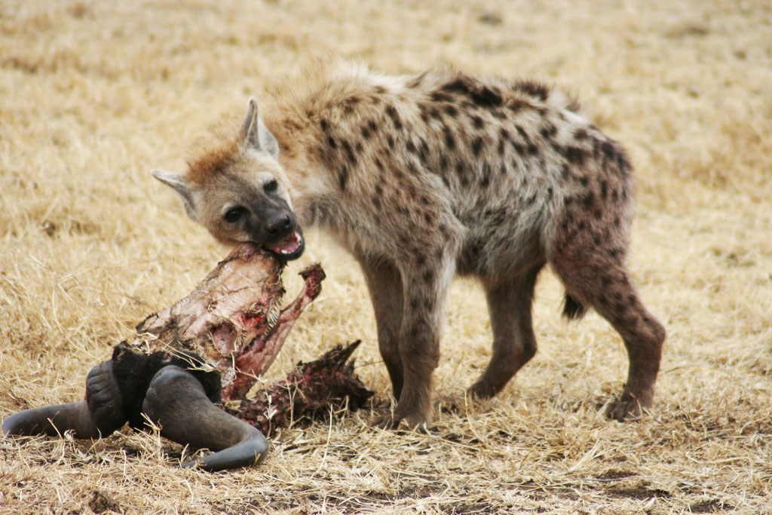
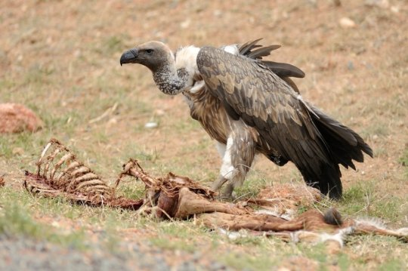
SCAVENGERS
Start the decomposition process by finding consuming carcasses of other animals that have been killed.
For Example: Hyenas, Crabs, Vultures.

Slide 6
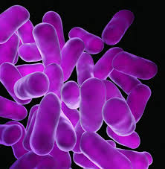
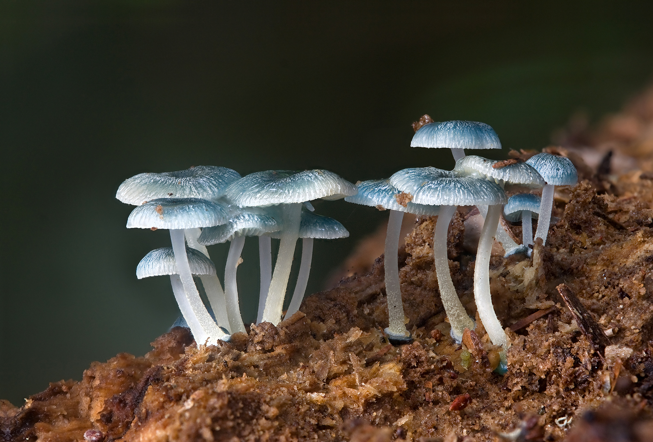
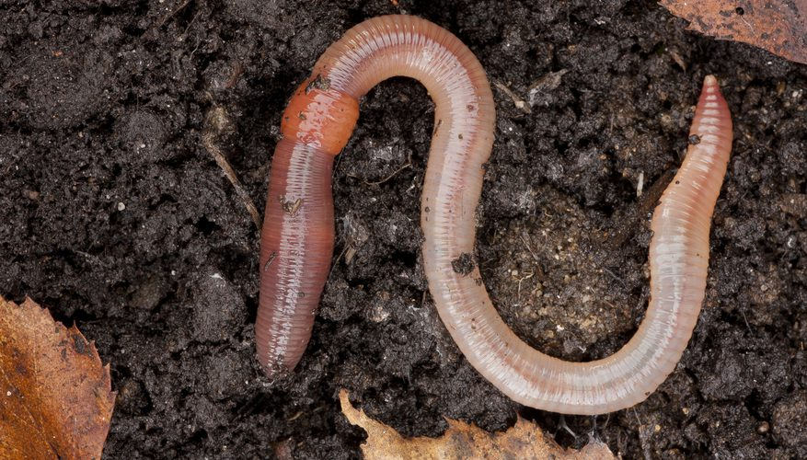
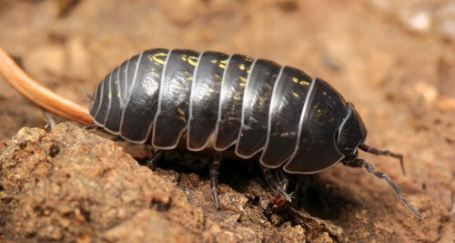
Decomposers/Detritivores
Decomposers feed by chemically breaking down organic matter (they don’t have mouths to consume with) into detritus.
Detritus are small pieces of decomposing plant and animal remains. These in turn are feed on by Detritivores.
Decomposer examples include bacteria and fungi.
Detritivore examples include earthworms, snails, shrimp, mites and crabs.

Slide 7
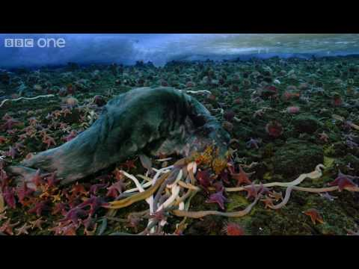
Decomposers/Detritivores
Decomposition releases nutrients that primary producers use to grow.
Without Scavengers, Decomposers & Detritivores, nutrients would remain locked within dead organisms.

Slide 8
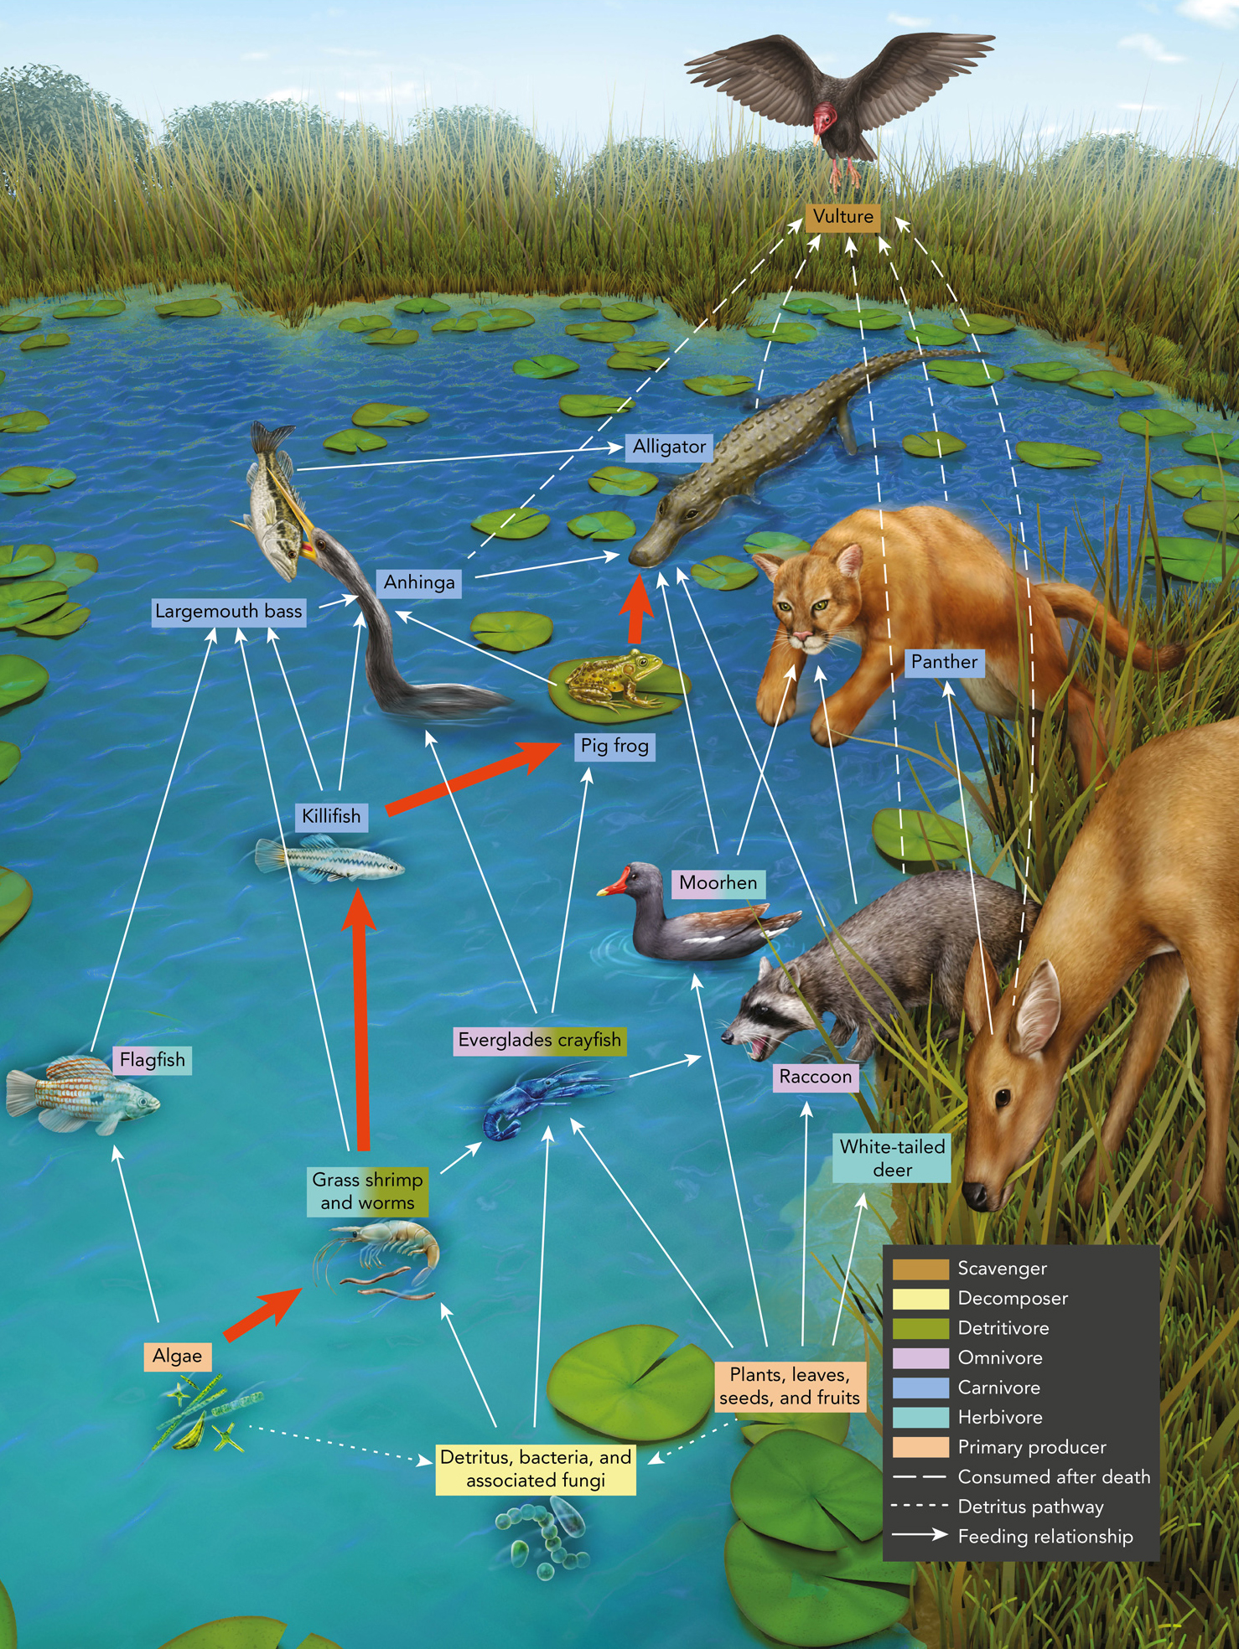
Energy Flow in Ecosystems
Organisms convert food (glucose) into energy.
As organisms are consumed they transfer that some of that energy onto the consumer.
Energy is a one way path. It is not a cycle.
Notes:
Note how decomposers and detritivores are incorporated in the food web. Use this to illustrate the differences between scavengers, decomposers and detritivores.

Slide 9
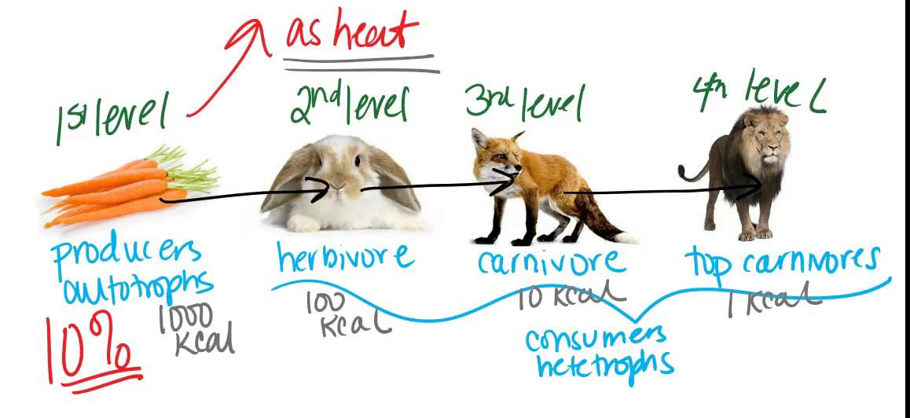
Energy Flow Models:

Slide 10
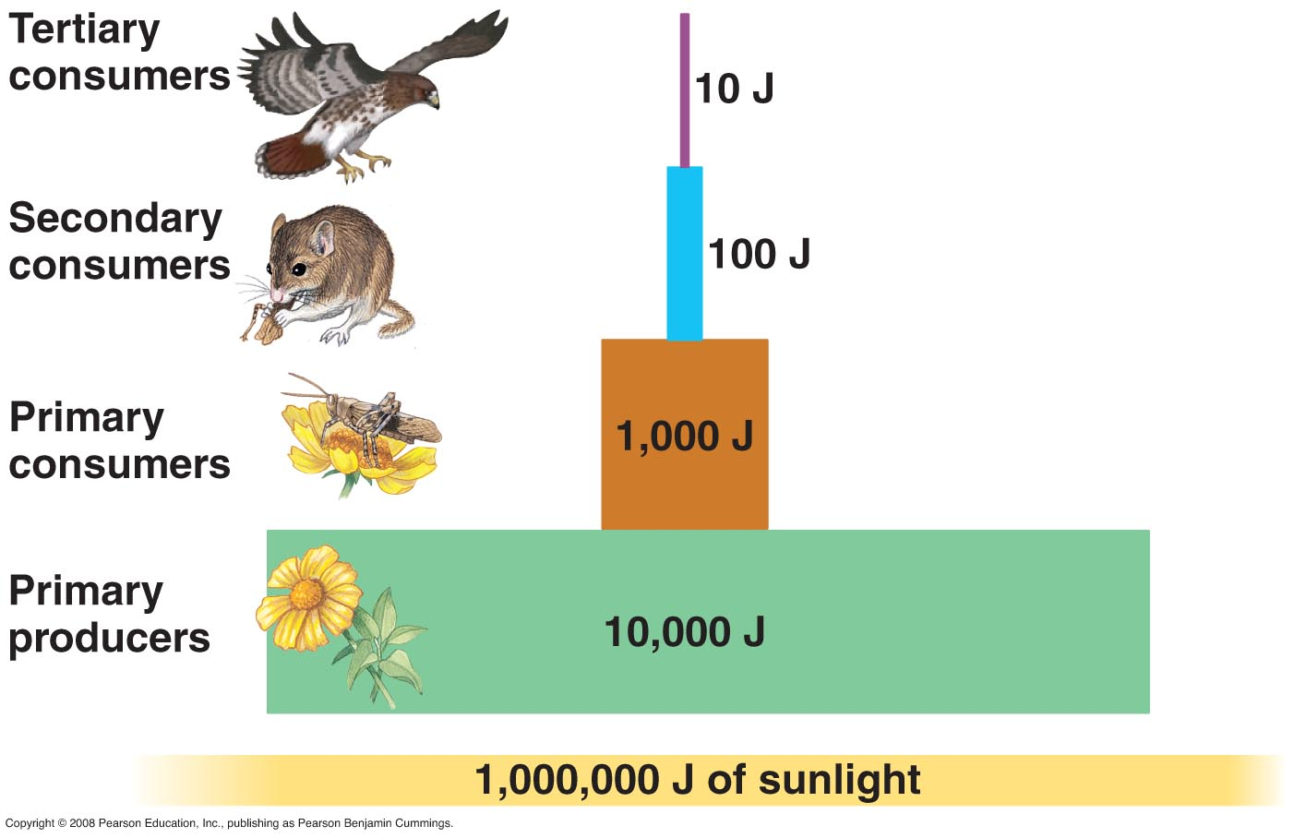
Energy Pyramid Model
An energy pyramid is a diagram that compares energy used by producers and consumers at each trophic (feeding) level.
Each level of the pyramid is called a trophic level.

Slide 11
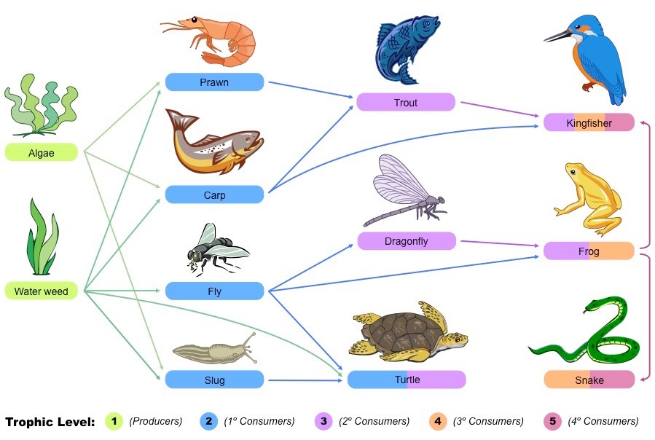
Energy Pyramid Model
Energy pyramids show 1 food chain in a food web. Producers are at the bottom of the food chain, so they appear at the bottom of the pyramid. Primary consumers are next and so on till the chain ends.

Slide 12
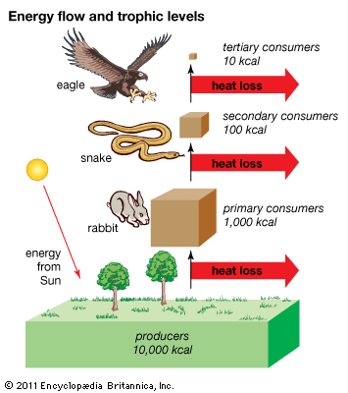
Energy Pyramid Model
10% of the energy available within one trophic level is transferred to the next.
On average 90% of the energy is either not consumed, or lost through waste and heat.

Slide 13
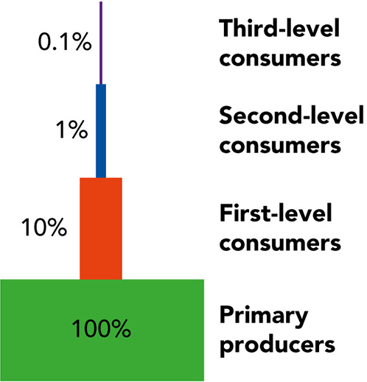
Energy Pyramid Model
Because of this exponential loss of energy, there reaches a limit in every food chain where there is no longer enough energy to support a higher trophic level.

Slide 14
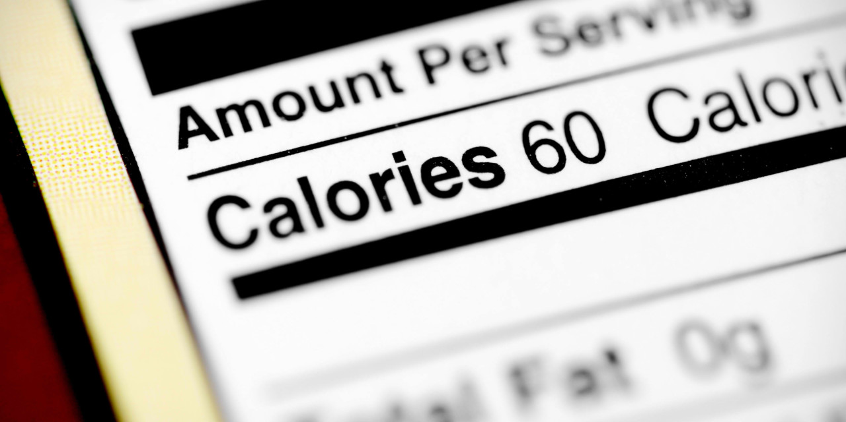
Energy Pyramid Model
Metric units of energy include:
calories (c)
joules (j)
How many calories are in a kilocalorie?
Notes:
The Calorie on nutritional labels is known as the “Big C” Calorie. It is actually just a kilocalorie, or a thousand “little c” calories.
1 calorie is the amount of energy needed to raise 1g of water by 1 degree Celsius.
A joule is the amount of energy equal to the work done by a force of one newton when its point of application moves 1 meter in the direction of the action of the force.

Slide 15
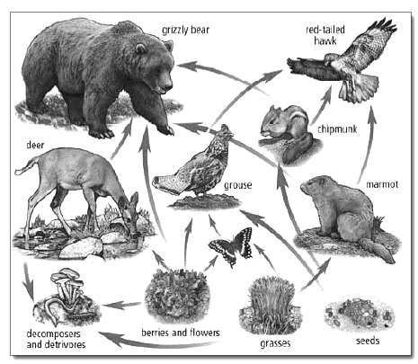
Student Task
Study the food web and convert a food chain from it into an energy pyramid model.
The autotrophs in this food web start off with 123,000 kilojoules of energy and the decomposers are included on the outside of the pyramid.
Also label the levels with the terms on paper

Slide 16
Hawk
Tertiary Consumer
123 kJ
Red-tailed hawk,
Bear,
Secondary Consumer
1,230 kJ
12, 300 kJ
Marmot, Grouse, Butterfly, Deer, Chipmunk, Bear
Primary Consumer
Producers
flowers, grasses (seeds, berries)
123,000 kJ

Slide 17
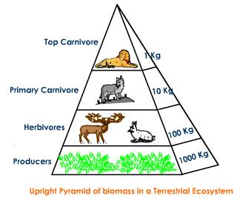
Biomass Pyramid Model
Biomass is the mass of organisms at a specific trophic level minus water.
Biomass refers to the amount of carbon and other trace elements an organism’s body contains.

Slide 18
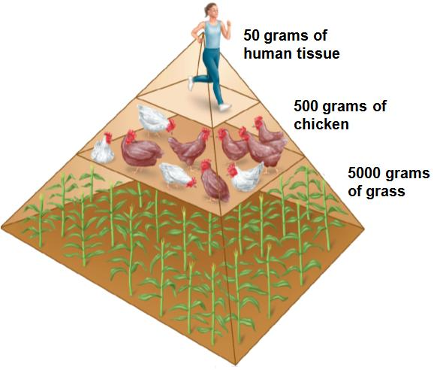
Biomass Pyramid Model
Energy is stored as biomass (in sugars, fats and to a lesser extent proteins) and so pyramids of biomass also decrease as energy decreases from trophic level to level.

Slide 19
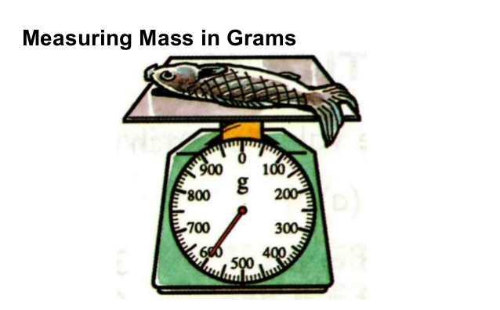
Biomass Pyramid Model:
Metric units of mass are:
grams (g)

Slide 20
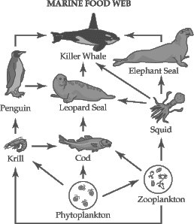
Student Task
Study the food web below and convert it into a biomass pyramid model.
The autotrophs (phytoplankton) in this food web start off with 5,693,112 Kg of biomass.
Also label the levels with the terms found on your paper

Slide 21
Student Task
Quaternary
Consumer
Whale
569 kg
Tertiary Consumer
Elephant Seal,
Killer Whale
5,693 kg
56,931 kg
Penguin, Leopard
seal, squid, cod
Secondary Consumer,
569,311 kg
Primary consumer,
cod, krill, zooplankton
5,693,112 kg
Phytoplankton
Producers

Slide 22
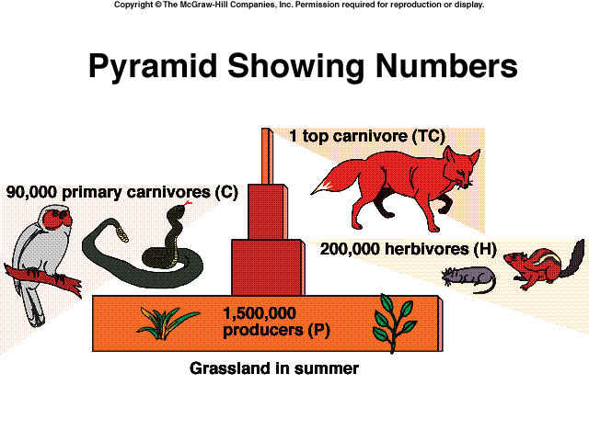
Pyramid of Numbers
Biomass can be converted into the actual number of organisms at each trophic level in a pyramid of numbers.

Slide 23
Being able to feed everyone on Earth is already a challenge. It will become even more so as our population on Earth grows. How can we feed more people in the future?
By growing more crops or by growing more meat?
How does this apply to you?

Slide 24
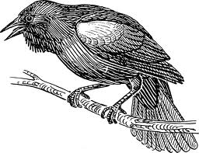
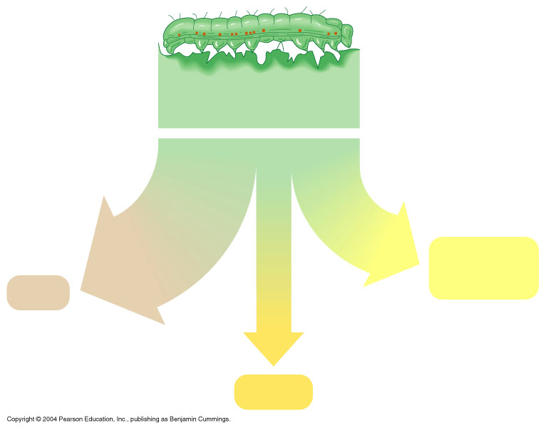
EXIT SLIP
Explain this graphic- feel free to draw it out.
In your answer, make sure to tell me:
How much energy did the plant start with?
How much energy will go to the crow? Why?
What will there be the most of in this ecosystem: plants, caterpillars, or crows?
How do you know?
Plant material eaten by caterpillar
100 kilocalories (kcal)
35 kcal
50 kcal
Cellular respiration
Feces
15 kcal
Growth

