Slide 1
Introduction to Organic Chemistry

Slide 2
Complementarity of Structure and Function
Examine the item that you and your neighbor have.
Identify two or more structures on or within it that enables it to perform its intended function.
Consider it’s shape, size, texture, flexibility, etc.
As you learn about different systems in biology keep considering how the structure contributes to the function of the organism
Can you recall characteristics of certain organelles you learned about that contribute to their function?
Notes:
**Add pictures of organelles from that powerpoint. They may need help with this…there might be other things we could bring up to…the point is to make them think about it because then they will think about WHY we learn about the structure of things (especially why we learn about the atoms and arrangement of the atoms of molecules)

Slide 3
Composition of Living Things
What makes up living things?
How do we get these building blocks?
The science of macaroni salad
https://www.youtube.com/watch?v=4WR0_gEEZ9I

Slide 4
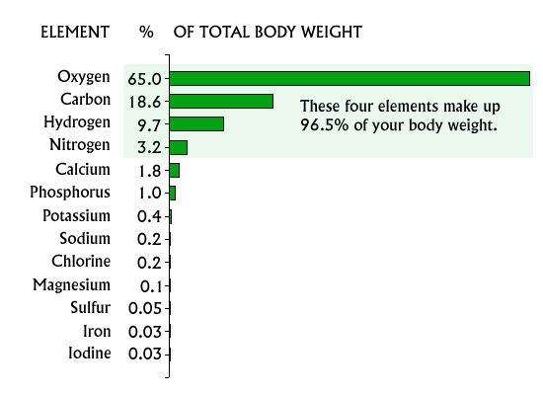
Composition of Living Things
Which atoms make up living organisms?
Of the 92 elements that naturally occur on Earth, about 25 are found in organisms
Just 4 make up about 96% of a human body’s mass (Meet the Elements)
Carbon (C)
Hydrogen (H)
Oxygen (O)
Nitrogen (N)
https://askabiologist.asu.edu/content/atoms-life
Notes:
We are going to zoom in deeper into the organelles studied in the last section. Now we will focus on several specific organelles and how their structure affects their function. We’ll start by looking at the atoms that make up most living things and then discover how those atoms combine to make compounds that are necessary for life functions.

Slide 5
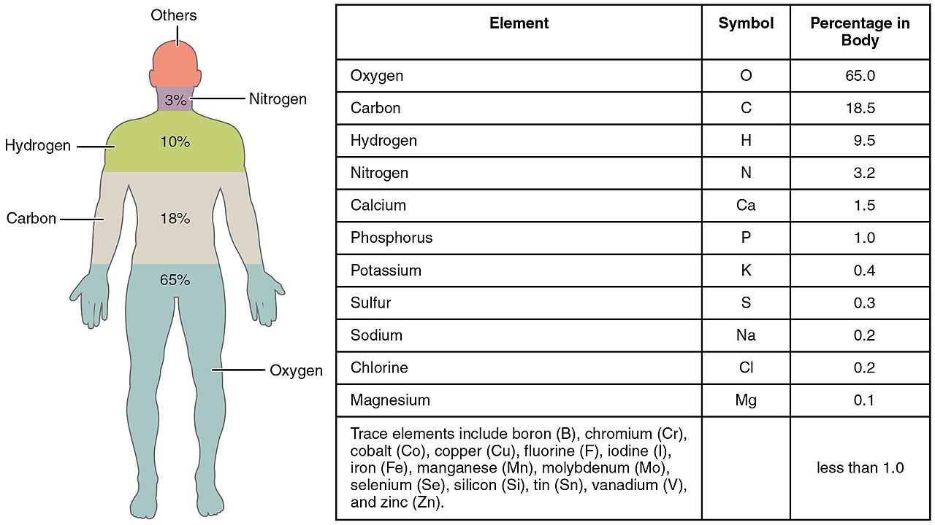
CHOPKINS CaFe Mg This sounds like an excellent small restaurant…say it out loud.
http://cnx.org/content/m45998/latest/?collection=col11496/1.6

Slide 6
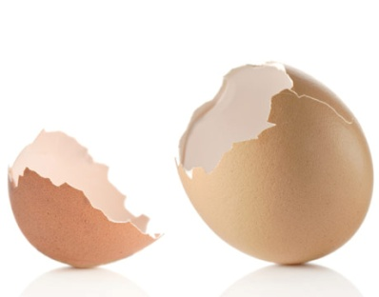
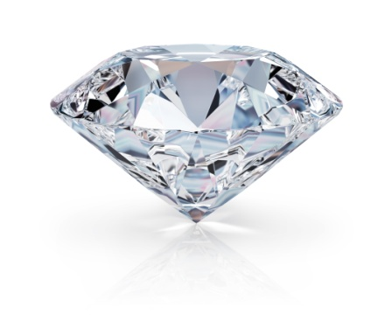
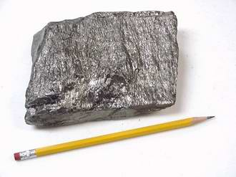
Inorganic vs. Organic Compounds
Historically, compounds isolated from plants and animals were deemed organic while those traced back to minerals were inorganic.
Organic compounds typically had carbon (C)
However, some molecules contain C, such as calcium carbonate (CaCO₃) and elemental forms of carbon (diamond and graphite), that are clearly inorganic.
Organic compounds are thus defined as containing BOTH carbon and hydrogen.
http://www.allthingskelly.com/wp-content/uploads/2014/06/Birthstone-For-April.jpg
http://www.goodhousekeeping.com/cm/thedailygreen/images/sw/egg-shell-lg.jpg
http://www.blog.iqsdirectory.com/wp-content/uploads/files/graphite%204.jpg
Notes:
Calcium carbonate is a chemical compound with the formula CaCO₃. It is a common substance found in rocks in all parts of the world, and is the main component of shells of marine organisms, snails, coal balls, pearls, and eggshells. Calcium carbonate is the active ingredient in agricultural lime, and is created when Ca ions in hard water react with carbonate ions creating limescale. It is commonly used medicinally as a calcium supplement or as an antacid, but excessive consumption can be hazardous.

Slide 7
Organic vs. Inorganic Compounds
Organic | Inorganic
Substance that contains BOTH carbon and hydrogen
Substance that does NOT contain BOTH carbon and hydrogen
*General rule is that they contain carbon
*Inorganic Examples with C: Carbon Monoxide (CO), Carbon Dioxide (CO₂), Cyanides
Types Essential to Life:
Carbohydrates (C₆H₁₂O₆)
Lipids
Nucleic Acids
Proteins
Types Essential to Life:
Water (H₂O)
Salts (NaCl)
Acids (HCl)
Bases (HCO₃-)
Notes:
Many cyanides are highly toxic. They disrupt the electron transport chain during cellular respiration.
HCl in stomach acid
Sodium Bicarbonate (NaHCO3) released by pancreas to help neutralize stomach acid to prep for nutrient absorption in the small intestines.

Slide 8
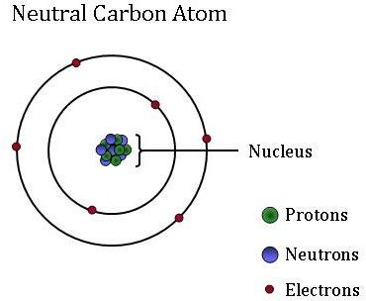
Carbon-Based Molecules
Carbon-based molecules form the structure of living things and carry out most of the processes that keep organisms alive.
Carbon can form up to 4 bonds.
Three fundamental structures:
Straight Chains
Branched
Rings
http://www.esrl.noaa.gov/gmd/outreach/isotopes/images/Carbon_atom.jpg
Notes:
**Animate so that the circles appear after the second bullet – provides an opportunity to talk about valence electrons

Slide 9
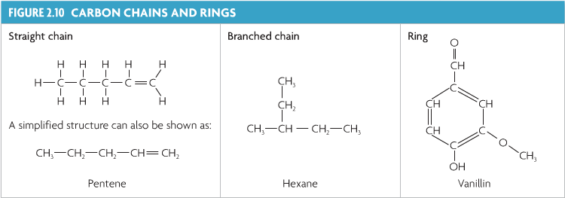
Fundamental Structures of Carbon-Based Molecules
It may seem simple…Share with your partner the different configurations above (relate the name to their structure) and how they show that carbon is forming 4 bonds.

Slide 10
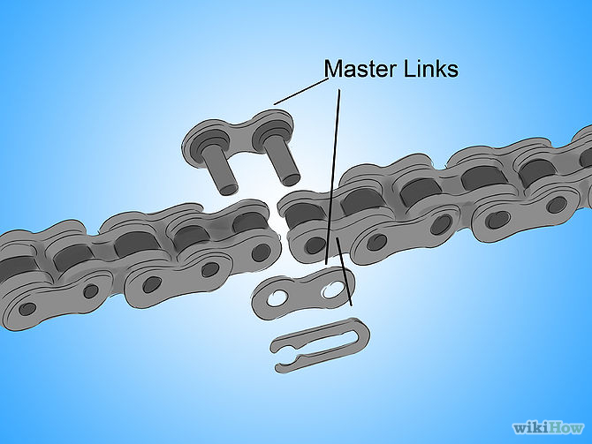
Monomer vs. Polymer
Small molecules act as subunits of the entire molecule.
Monomer: each subunit in a complete molecule
Polymer: a large molecule, or macromolecule, made of many monomers bonded together.
All of the monomers can be the same (i.e. carbohydrates) or different (i.e. proteins).
http://www.wikihow.com/Put-On-a-Bicycle-Chain

Slide 11
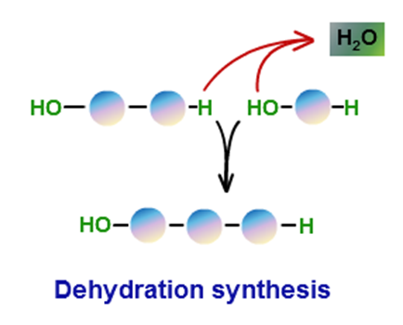
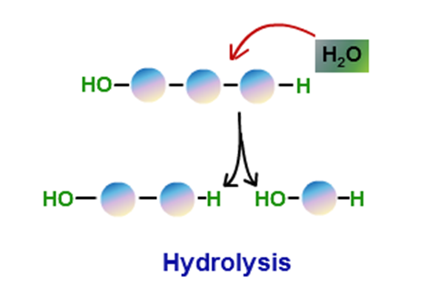
Building Up and Breaking Down Molecules
Forming larger molecules | Breaking bigger molecules into smaller ones
Dehydration Synthesis
Hydrolysis
Sketch a simple drawing in your notes
http://images.tutorvista.com/cms/images/81/dehydration-and-hydrolysis.png
Notes:
**Relate to digestion??

Slide 12
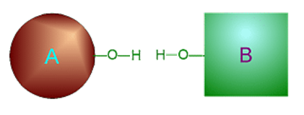
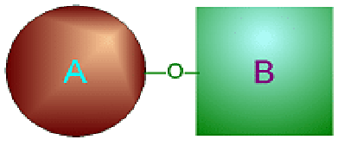
Dehydration Synthesis – Build Up
Synthesis
to create (to put together, to make bigger)
Dehydration
to take out water
+ H₂O
+ H₂O

Slide 13
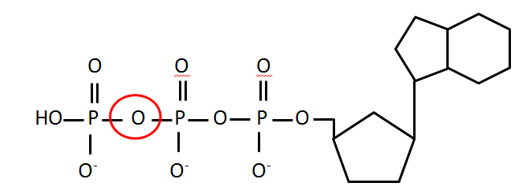
Ex: Dehydration Synthesis of ATP
**ATP is a molecule that stores readily usable energy for cells.
A phosphate group is added to the end.
In doing so, energy is stored to be used by the cell.
This is a VERY important molecule in biology!
http://www.mikeblaber.org/oldwine/BCH4053/Lecture05/atp_hydrol01.gif

Slide 14
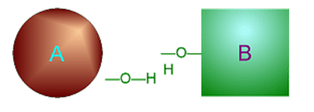
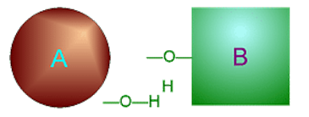
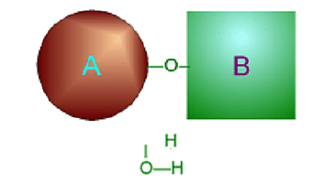
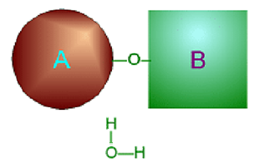
Hydrolysis – Break Down
Lysis
to split
Hydro
water (H₂O)
+ H₂O
Notes:
HOW DO I GET THE ANIMATION TO WORK LIKE FOR DEHYDRATION SYNTHESIS….?? Tried to make it and it is not great.

Slide 15
Ex: Hydrolysis of ATP
This is a VERY important molecule in biology!
A phosphate group is cleaved (removed) from the end.
In doing so, energy is released to be used by the cell.
http://dm.ncl.ac.uk/helencollard/files/2009/04/atp.gif

Slide 16
Four Main Classes of Organic Macromolecules
Each of these molecules are made up of smaller parts. Understanding what they are made of helps you understand their function.
Lipids
Carbohydrates
Nucleic Acids
Proteins
Notes:
Add anything about where these are found…or which organelles they are associated with to connect to prior knowledge??

Slide 17
Macromolecule Table
We will come back to this table after each macromolecule we cover. It may be a good idea to tab this page with something like a sticky note.
Macromolecule | Lipids | Carbohydrates | Nucleic Acids | Proteins
Types of Atoms
Monomers made of
Function(s)
Examples
Sketch

Slide 18
Good Resources (for Teacher)
Section 2.3 in the Biology Book!!
http://2012books.lardbucket.org/books/principles-of-general-chemistry-v1.0/s28-06-the-molecules-of-life.html
http://www.ncbi.nlm.nih.gov/books/NBK26883/

Slide 19
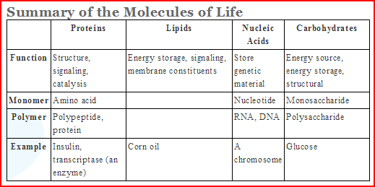
http://www.sparknotes.com/testprep/books/sat2/biology/chapter5section5.rhtml

Slide 20
Standards Related to Topic
NGSS | National | WA State
HS-LS1-6. Construct and revise an explanation based on evidence for how carbon, hydrogen, and oxygen from sugar molecules may combine with other elements to form amino acids and/or other large carbon-based molecules.[Clarification Statement: Emphasis is on using evidence from models and simulations to support explanations.] [Assessment Boundary: Assessment does not include the details of the specific chemical reactions or identification of macromolecules.] Multicellular organisms have a hierarchical structural organization, in which any one system is made up of numerous parts and is itself a component of the next level. (HS-LS1-2) As matter and energy flow through different organizational levels of living systems, chemical elements are recombined in different ways to form different products. (HS-LS1-6),(HS-LS1-7)

