Slide 1
Genetics Take 2
Dihybrid Crosses

Slide 2
Monohybrid vs. Dihybrid
Monohybrid crosses are crosses that examine the inheritance of only one specific trait.
Dihybrid crosses are crosses that examine the inheritance of two different traits.

Slide 3
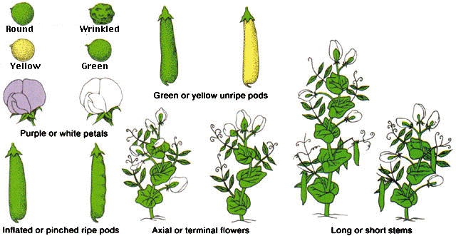
Mendel and Dihybrid Crosses
Mendel studied dihybrid crosses.
He crossed a plant with yellow round peas with a plant with green wrinkled peas.

Slide 4
Mendel and Dihybrid Crosses
Mendel began his experiments with purebred (homozygous) parent plants. RRYY x rryy
Remember each trait has 2 genes due to getting half your genes from mom and half from dad.
How many gamete options do you have for RRYY??
RY
rryy?
ry
These are the gametes from the “P” generation.

Slide 5
Mendel and Dihybrid Crosses
“P” generation: RRYY x rryy
RRYY
rryy
 | RY | RY | RY | RY
ry | RrYy | RrYy | RrYy | RrYy
ry | RrYy | RrYy | RrYy | RrYy
ry | RrYy | RrYy | RrYy | RrYy
ry | RrYy | RrYy | RrYy | RrYy

Slide 6
Mendel and Dihybrid Crosses
What is the genotypic ratio?
16 RrYy:0 anything else
Phenotypic ratio?
16 Round Yellow:
0 anything else
 | RY | RY | RY | RY
ry | RrYy | RrYy | RrYy | RrYy
ry | RrYy | RrYy | RrYy | RrYy
ry | RrYy | RrYy | RrYy | RrYy
ry | RrYy | RrYy | RrYy | RrYy

Slide 7
Mendel and Dihybrid Crosses
He then crossed two “F₁” organisms:
RrYy x RrYy
RrYy
 | RY | Ry | rY | ry
RY | RRYY | RRYy | RrYY | RrYy
Ry | RRYy | RRyy | RrYy | Rryy
rY | RrYY | RrYy | rrYY | rrYy
ry | RrYy | Rryy | rrYy | rryy
RrYy

Slide 8
Mendel and Dihybrid Crosses
 | RY | Ry | rY | ry
RY | RRYY | RRYy | RrYY | RrYy
Ry | RRYy | RRyy | RrYy | Rryy
rY | RrYY | RrYy | rrYY | rrYy
ry | RrYy | Rryy | rrYy | rryy
What is the genotypic ratio for the F2 generation?
1 RRYY:2 RRYy: 1 RRyy: 2 RrYY: 4 RrYy: 1 rrYY: 2 Rryy: 2 rrYy: 1rryy

Slide 9
Mendel and Dihybrid Crosses
Phenotypic ratio for the F2 generation?
 | RY | Ry | rY | ry
RY | RRYY | RRYy | RrYY | RrYy
Ry | RRYy | RRyy | RrYy | Rryy
rY | RrYY | RrYy | rrYY | rrYy
ry | RrYy | Rryy | rrYy | rryy
9:16 Round Yellow,
3:16 Round Green,
3:16 Wrinkled Yellow,
1:16 Wrinkled Green

Slide 10
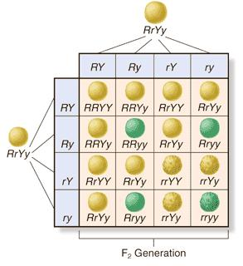
Mendel and Dihybrid Crosses
9:16 yellow and round,
3:16 green and round,
3:16 wrinkled and yellow,
1:16 wrinkled and green.

Slide 11
Mendel and Dihybrid Crosses
Mendel continued to find this approximately 9:3:3:1 phenotypic ratio in the F₂ generation, regardless of what 2 different traits he chose.

Slide 12
Mendel and Dihybrid Crosses
This is due to his Law of Independent Assortment.
Each allele pair arrange themselves independently from other allele pairs during meiosis (gamete formation)…

Slide 13
Dihybrid Cross Practice
Suppose you are studying the color and texture of kernels on a corn cob.
Kernels can be either purple (R) or yellow (r).
They can also be smooth (T) or shrunken (t).
Predict the phenotypic and genotypic outcome of crossing a heterozygous purple and heterozygous smooth with a yellow shrunken.

