Slide 1
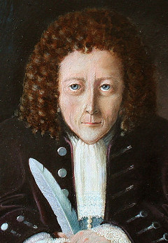
I discovered Cells
(p.s.Newton can eat my socks)

Slide 2
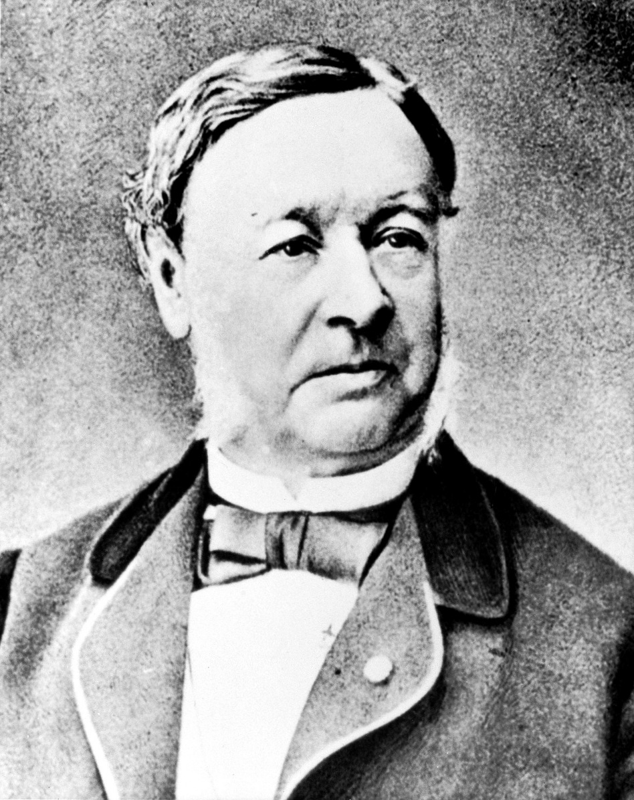
I concluded that all animals are made of cells

Slide 3
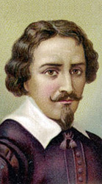
I invented the microscope and that’s really it…

Slide 4
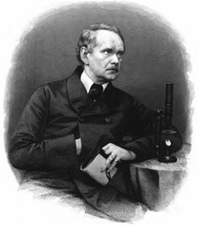
I concluded that all plants are made of cells

Slide 5
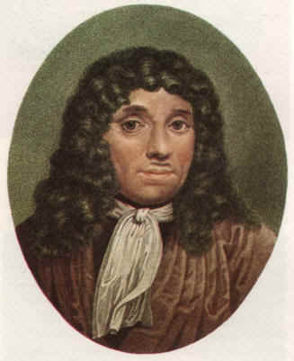
I discovered bacteria, sperm, blood cells and I look good in a wig.

Slide 6
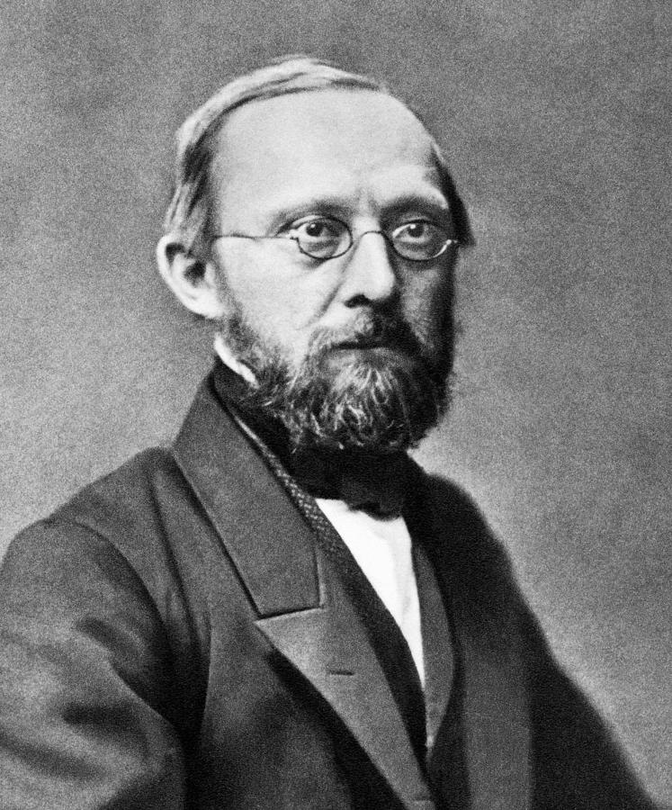
I came up with the Cell Theory, but no one ever remembers me…

